Slide 1
Learning More about Community Building

Slide 2
Information for this presentation comes from
the Foundation for Community Encouragement
and from the book
The Different Drum: Community Making and Peace, by M. Scott Peck

Slide 3
Outcome– what I hope you will be able to know by the end
1. Evaluate the difference in feeling between pseudo-community and genuine community, based on past experiences in your own life history and new knowledge that I give you today.
What does genuine community feel like?
How is it different?

Slide 4
Outcome– what I hope you will be able to know by the end
2. Identify and describe the stages of the Community Building process.
What are the stages in the community building process?
What is the significance of each stage?

Slide 5
Preview of talk
1. Encourage you to think about what you already know about a sense of genuine community.
2. Look at 4 stages of CB process and identify the vital ‘turning point’ in this process.
3. Explore the dynamic of chaos-crisis in the CB process. (with visual aids)
4. Discuss different modes of action that you can engage in if you are attracted to the principles of community building.

Slide 6


Part I– What you already know about a sense of genuine community
Recall a place and time when you did NOT feel heard, understood, accepted, or appreciated.

Slide 7
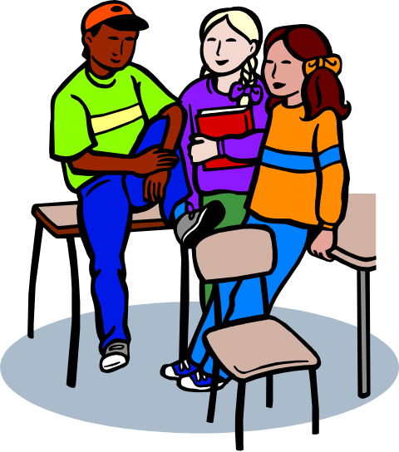
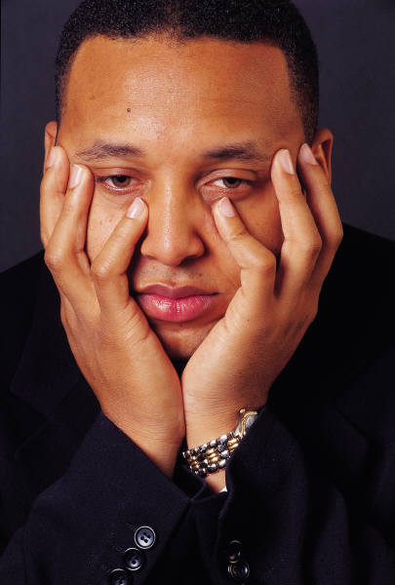
Jot some notes on the scenario–
What was said?
What was not said?
Now write down words that describe the range of emotions that you felt at that time.
(group share as BLUE words)

Slide 8
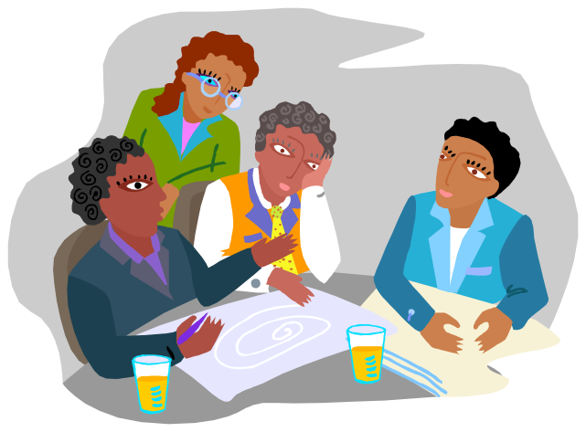
NOW
Recall a place and time when you DID feel heard, understood, accepted, or appreciated.

Slide 9

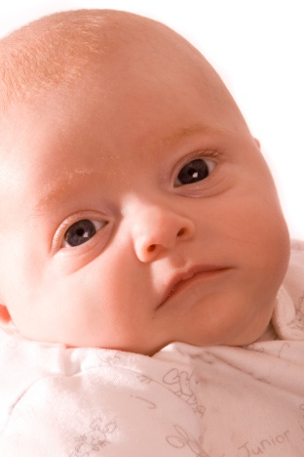
Jot some notes on the scenario–
what was said?
how was it said?
what was your response on a heart level?
Now write down words that describe the range of emotions that you felt at that time.
(group share as GREEN words)

Slide 10
community building
lets us
shift from
BLUE
to
GREEN
community building is a way to move from living with lots of blue words in our life to finding a protected way to allow the number of green words to grow and multiply

Slide 11
BLUE feelings are feelings
we experience in the chaos of social crises
BLUE feelings emerge in:
domestic violence
drug abuse
coming out issues
eating disorders
grief

Slide 12
BLUE feelings
people have been sitting on
blue feelings
for a long time
acting like they ‘have it all together’
or feeling excluded
or cutting themselves off
from their own heart
from the need to give and receive love
in our world

Slide 13

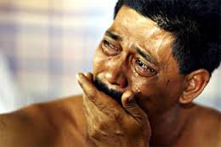
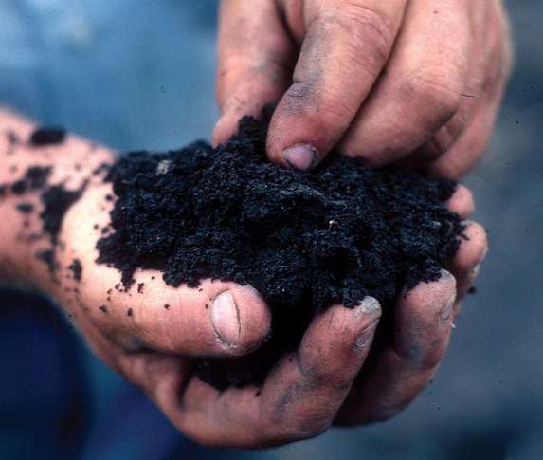
In Community Building, rather than run away from painful BLUE feelings of crisis, we can understand this truth as a GIFT, a transformation point.

Slide 14
How do we move from the blue to the green?
let’s look at the Community Building process
and discover how break-throughs in communication, and personal and group transformation happen

Slide 15
Part II– The stages in the Community Building process
Community Building is a process we engage in, not a pre-made product that we have access to instantly.
The Community Building process moves in stages,
like any creative, emergent process.
There are four stages.
On the whole, the stages are sequential, but the process is dynamic, and there is no set formula or time frame for how genuine communities emerge.

Slide 16
IN THE BEGINNING…
Let’s think about a time when you first get together with a group—
  What does it feel like?
  What do you talk about?
  How honest are you about real feelings?
  What kinds of ways do you think people are assessing and judging each other?

Slide 17
THE PSEUDO-COMMUNITY STAGE
“The first response of a group in seeking to form a community is most often to try to fake it. The members attempt to be an instant community by being extremely pleasant with one another and avoiding all disagreement. This attempt– this pretense of community—is what I term ‘pseudo-community.’ It never works.” p. 86-87 Chapter V, Stages of Community-Making, The Different Drum

Slide 18
Invariably, what happens from here? What begins to change over time?
differences emerge…? what happens if differences escalate?

Slide 19
THE CHAOS STAGE
“In the stage of chaos individual differences are, unlike those in pseudo-community, right out in the open. Only now, instead of trying to hide or ignore them, the group is attempting to obliterate them.” p. 91, The Different Drum

Slide 20
In the ‘Chaos Stage’, two motives are present:
make everyone ‘normal’
be the person or dominant group to ‘win’, as members fight over whose norm might prevail

Slide 21
to consider…
most of group life is chaos
power struggles
that are voiced or silent
to assert
life-controlling
norms
of pseudo-community
What do the power struggles of chaos feel like?
BLUE FEELINGS
shut out, crushed, ignored, anger at denial, frustration at avoidance, fear of further exclusion

Slide 22
HOW DO WE GET OUT
OF THE CHAOS STAGE?
“There are only two ways out of chaos… One is into organization– but organization is never community. The only other way is into and through emptiness.” –p. 94 The Different Drum
THIS IS THE CRISIS TRANSFORMATION POINT

Slide 23
THE EMPTINESS STAGE
there is only
ONE
way out of chaos
to genuine community….
that way
is through
EMPTINESS

Slide 24
“Emptiness is the hard part. It is also the most crucial stage of community development. It is the bridge between chaos and community.”
--p. 101, The Different Drum

Slide 25
“Because the stage of emptiness can be so painful, there are two questions I am routinely asked with agony. One is, “Isn’t there any way into community except through emptiness?” My answer is “No.” The other question is, “Isn’t there any way into community except through the sharing of brokenness?” Again my answer is “No.”” p. 101 The Different Drum

Slide 26
“As a group moves into emptiness, a few of its members begin to share their own brokenness—their defeats, failures, doubts, fears, inadequacies, and sins. They begin to stop acting as if they ‘had it all together’ as they reflect on those things they need to empty themselves of.” p. 101 The Different Drum

Slide 27
What are things people need to
empty, let go of, grieve over, vent?
EXAMPLES
prejudices, expectations, fears, past judgments and hurts…

Slide 28
THE GENUINE COMMUNITY STAGE
Finally, genuine community …
“The transformation of a group from a collection of individuals into genuine community requires little deaths in many of those individuals. But it is also a process of group death, group dying… Whether sudden or gradual… all the groups in my experience have eventually succeeded…They have all made it through emptiness, through the time of sacrifice, into community. This is an extra-ordinary testament to the human spirit. --p. 102 The Different Drum

Slide 29
GENUINE COMMUNITY
“When its death has been completed, open and empty, the group enters community. In this final stage a soft quietness descends. It is a kind of peace. The room is bathed in peace. Then, quietly, a member begins to talk about herself. She is being very vulnerable. She is speaking of the deepest part of herself. The group hangs on each word. No one realized she was capable of such eloquence.” p. 103, The Different Drum

Slide 30
Once a group has found genuine community, they can grow from that place. They have found the conditions, and the ground of principles and shared intention, to experience GREEN words and to allow them to grow.
“Community Building first.
Problem Solving second.”

Slide 31
let’s review…
take a look now at the printed flow map

Slide 32
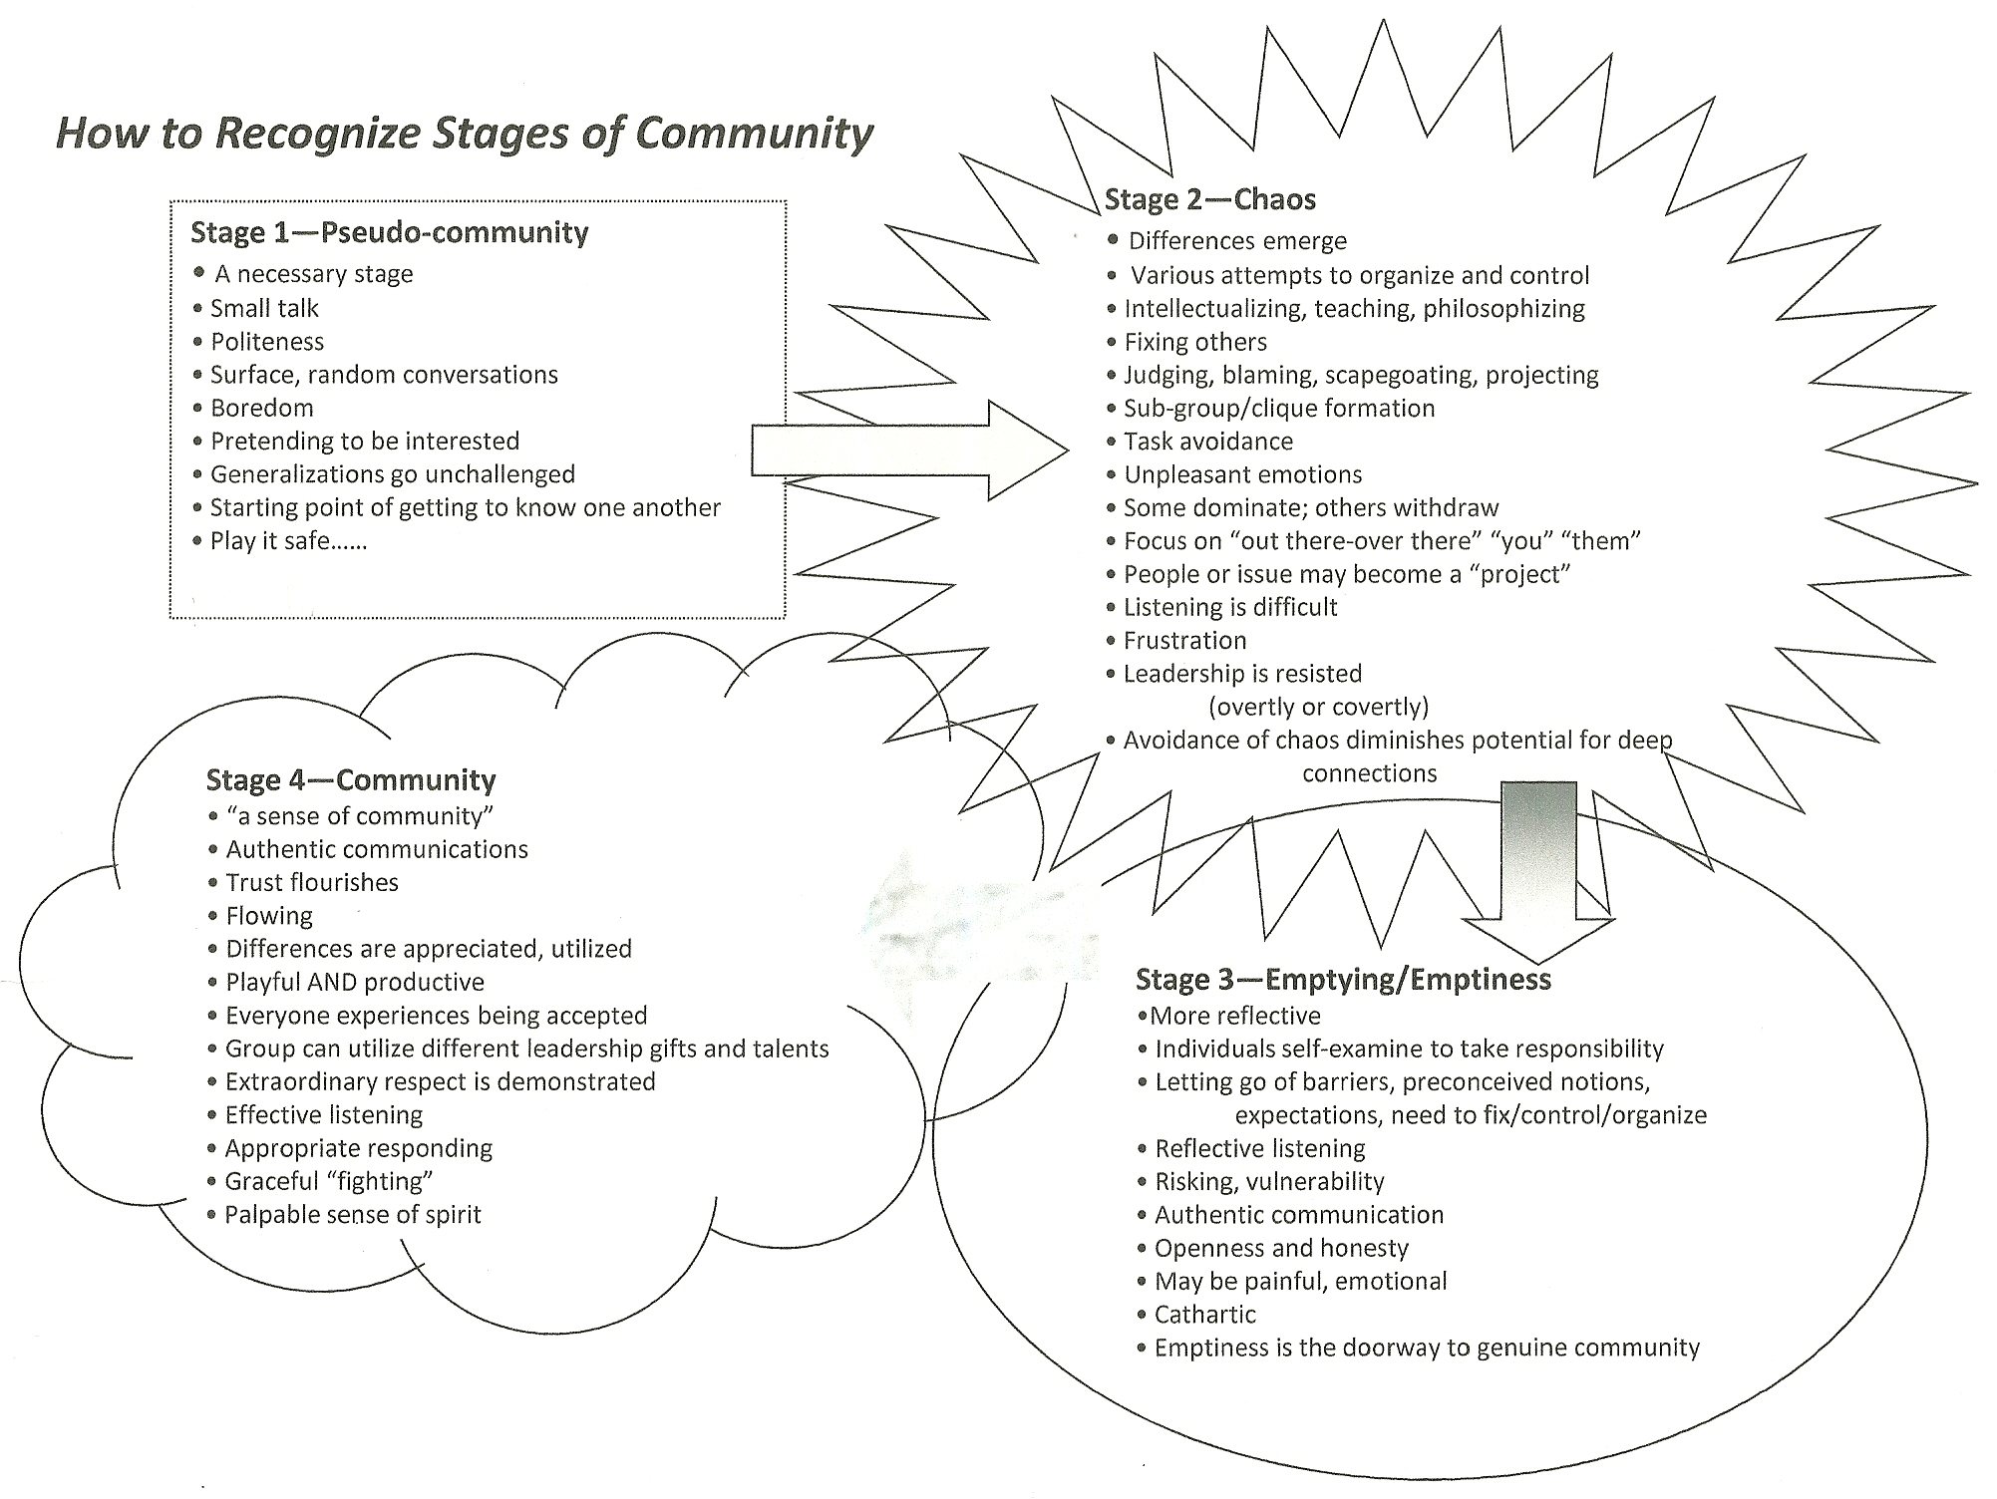
Review ‘shape’ worksheet on stages of community building.

Slide 33
Part III– How does the community building process transform our ability to integrate and learn from chaos-crisis?

Slide 34
The Reality:
We live in a world of pseudo-community and chaos.
without intention
to enter into the stages of the community building process,
without guiding principles
to create the conditions for genuine community to emerge,
genuine community does not just ‘happen’

Slide 35
Let’s explore the difference between a life that is lived always through pseudo-community and a life that is lived through genuine community.

Slide 36
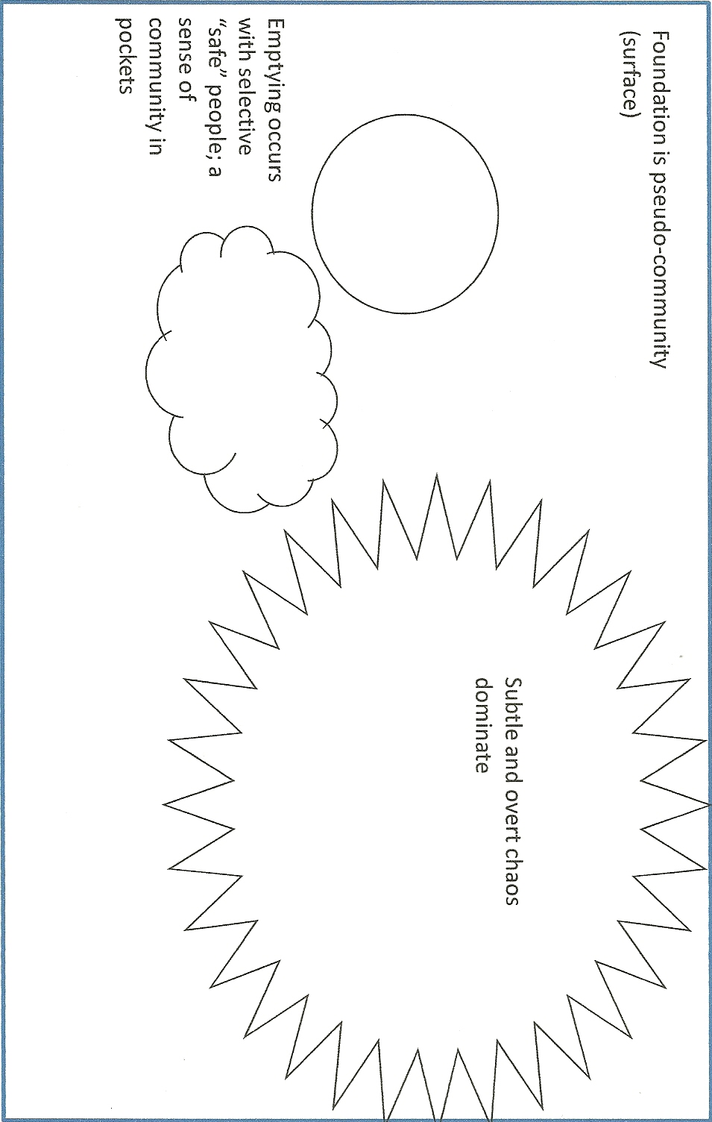
Consider a world where pseudo-community is the standard way of relating

Slide 37
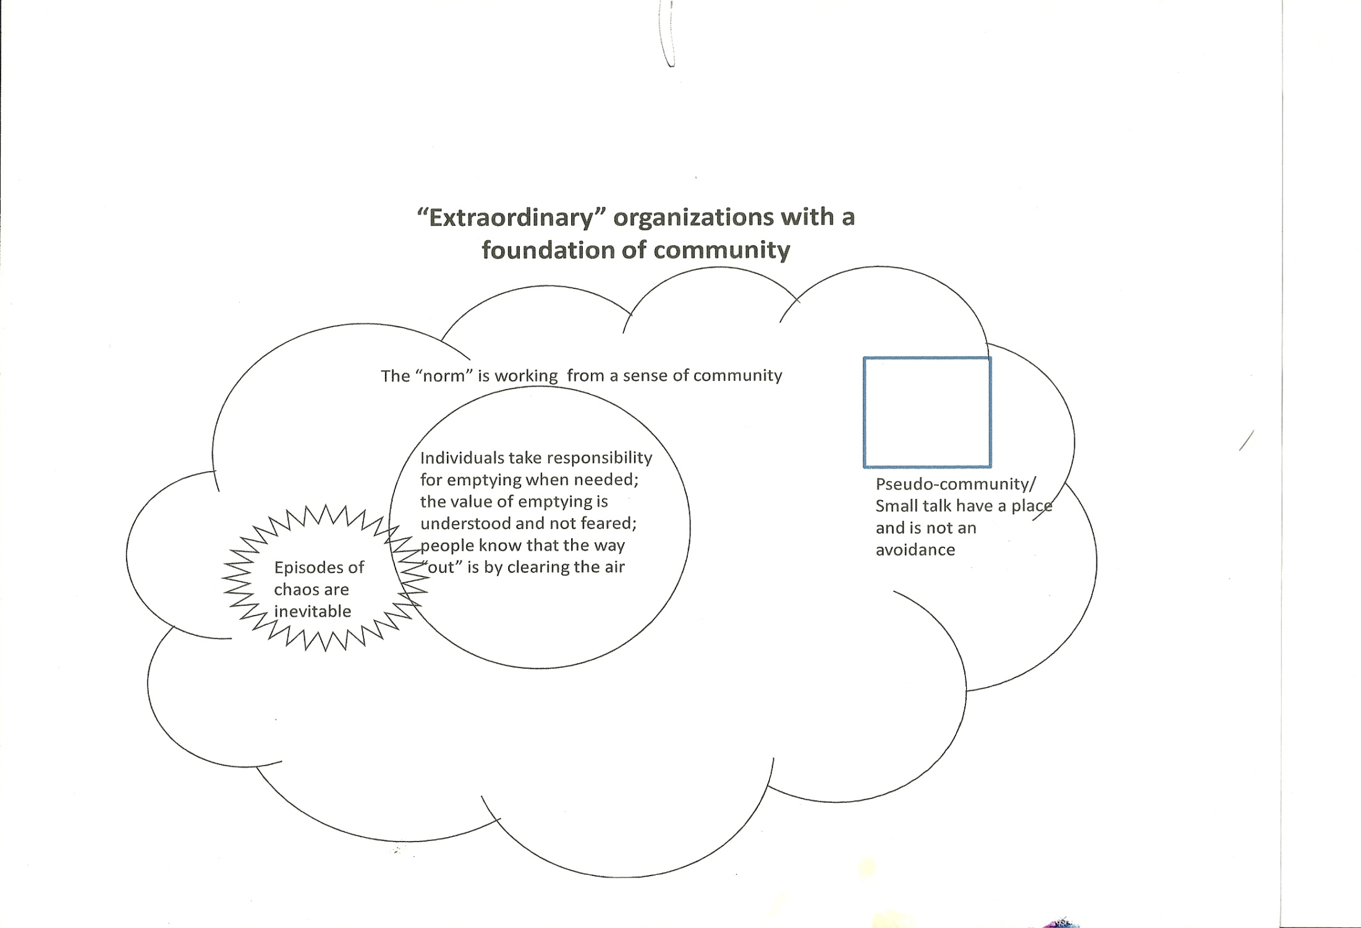
Consider a world where genuine community is the foundation or ‘norm’

Slide 38
in which norm is emptiness allowed to be more present and experienced?
Emptiness in pseudo-community
Emptiness in genuine community

Slide 39
What is the relationship between the amount of heart space we give to emptiness and the size and effect of chaos on the group?
emptiness and chaos in genuine community
chaos and emptiness in pseudo-community

Slide 40
Questions for reflection
Consider the transformed ways of thinking about crisis and community. What are the possibilities when we understand how crisis is related to community?
How could your role as a crisis interventionist be uplifted from the static role of a ‘helper’ and ‘fixer’ to the dynamic role of someone, who, within a creative and uplifted mind, creates conditions and intentions for meaningful transformation through community building and deepened standards of communication

Slide 41
Conclusion
Where to go from here?
1. Learn more about Community Building by joining the college group– read The Different Drum, participate in a full FCE workshop, prepare to be trained as a facilitator, learn about themes that emerge in each stage and much more, practice CB regularly with a group.

Slide 42
2. Learn about Community Building variations– CB with children, CB through Needs Assessments, new forms of CB that include expression through the arts and ways of including people with disabilities.
https://www.youtube.com/watch?v=armP8TfS9Is&index=2&list=PLth4HhHITDRFfgIaKmtIaGy3EEvI45Z2p Community Building with Children

Slide 43
Learn about Participatory Action Research (PAR) models happening in Appalachia and South America and different parts of the world. Once a Community Building Group is established, there are great possibilities for social transformation using PAR methodologies!
Reading, Analyzing, and Transforming Reality through Participatory Research
with Dr. Shabnam Koirala-Azad
http://www.bahai-studies.ca/PastWebinars
Creative Placemaking and Belonging– Participatory Action Research with Theater through Southeast Kentucky Technical and Community College
with Dr. Robert Gipe
http://namac.org/idea-exchange/creative-placemaking-belonging

Slide 44
Learn about new ways that mental health workers in Appalachia are thinking about their social role– 3 levels of involvement.
Individual healing– one-on-one traditional therapy
Community empowerment– establishing ‘Safe Havens’, Community Building Groups, local advocacy groups, Participatory Research teams
National and global social transformation– advocacy to change standards in mass communication, education, public health, government so we have an ethic of nurturance and care for all life.
Julie Shepherd-Powell
PhD Candidate, University of Kentucky
julie.shepherd.powell@gmail.com

Slide 45
Contact information:
Julie Geredien
jgeredien@gmail.com
Foundation for Community Encouragement
http://fce-community.org/

