Slide 1

Harmonizing Motivations: Dialogue for Action and Social Change
Carl S. Moore, Ph.D.
Associate Professor
Research Academy for Integrated Learning
University of DC
Notes:
Script for slide 1:

Slide 2

Outcomes
It is my aim that after leaving this workshop participants will:
Have a greater understanding of social justice.
Be able to evaluate oneself as a potential change agent.
Be able to collaborate with others to make decisions for social change.

Slide 3

Icebreaker
As it relates to social change in the world, discuss one thing you would like to see change in the world and one major barrier (in your opinion) to that change.

Slide 4
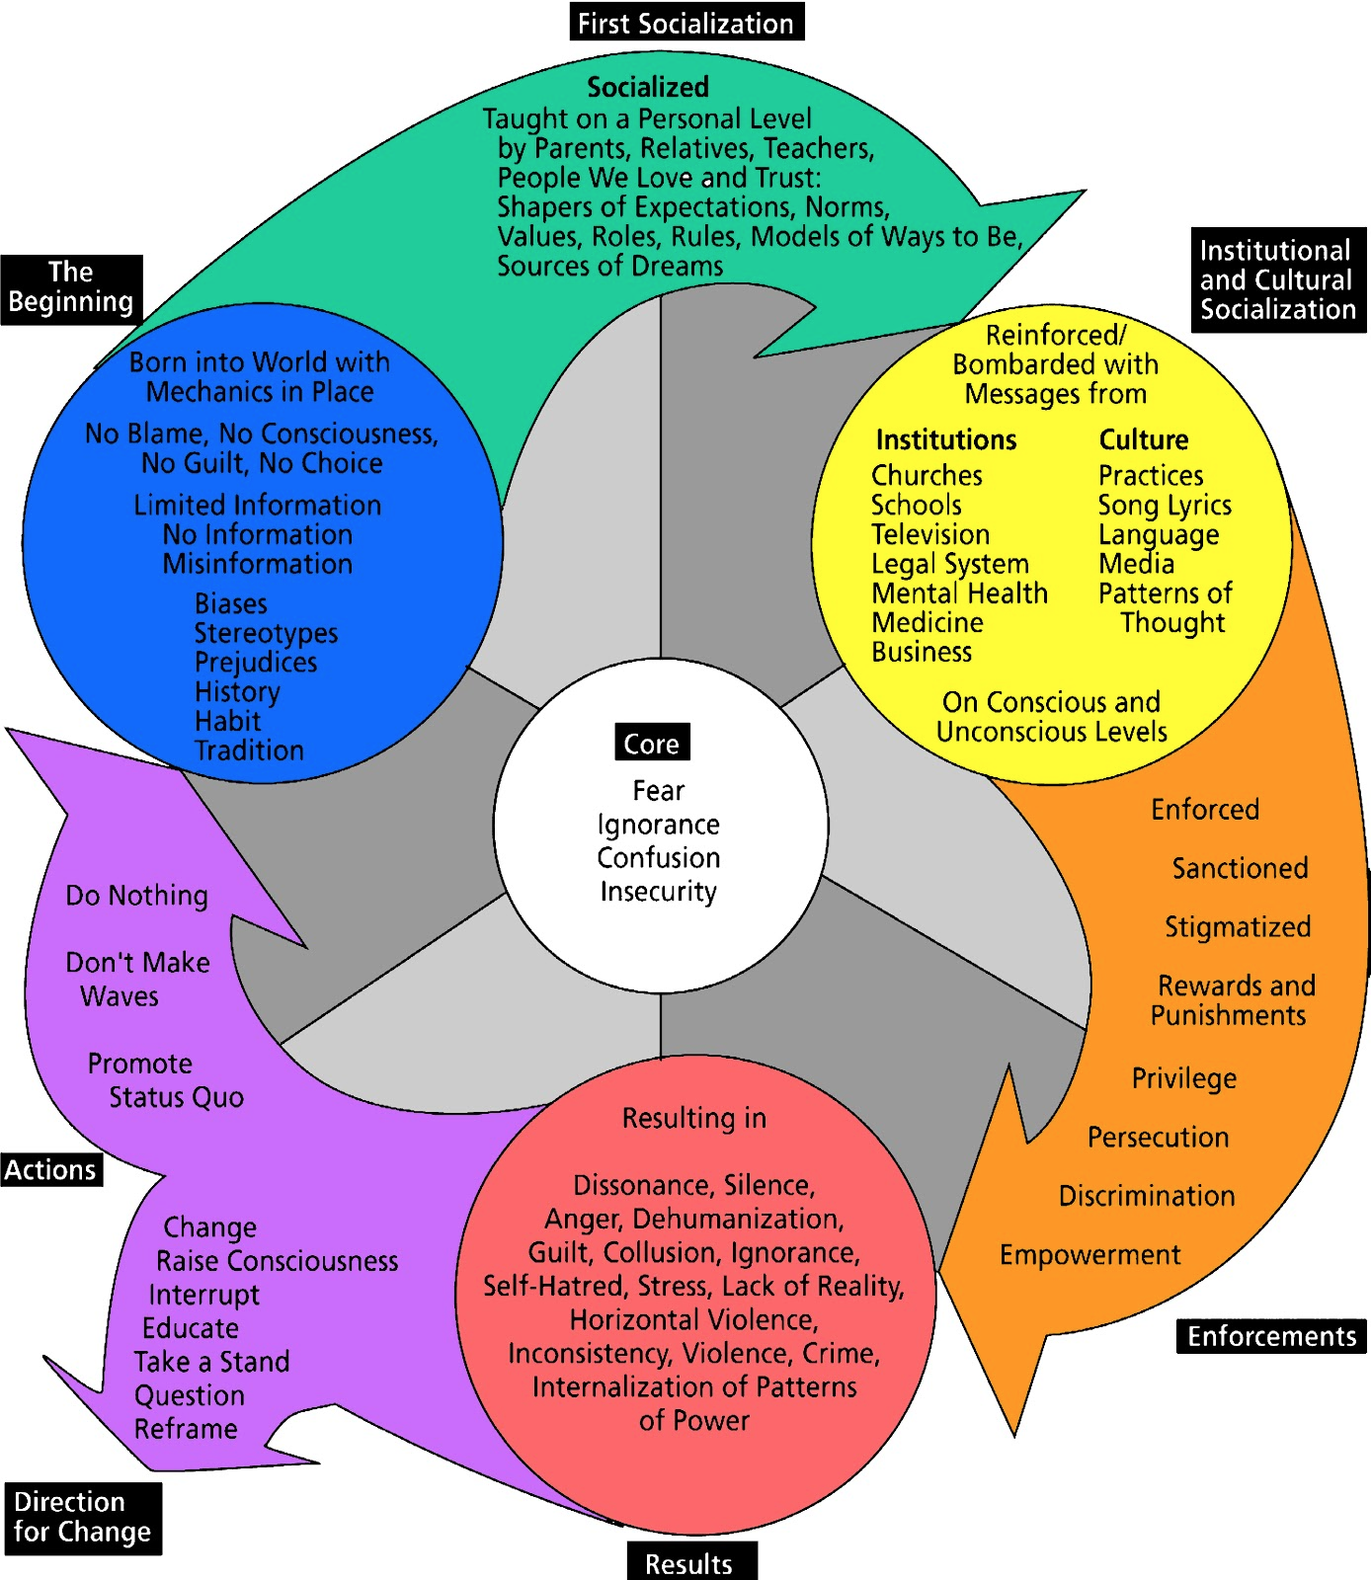
Cycles of Socialization
Harro, B. (2000). The cycle of socialization. Readings for diversity and social justice, 15-21.

Slide 5

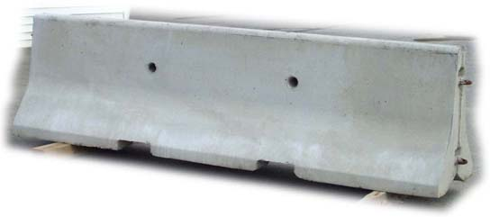
Levels of Social Interaction…
Individual
Communal
Institutional (Systemic)
Violence serve as barriers to social interaction.

Slide 6
Violences
Physical Harm, Mistreatment, Abandonment, Guilt
What is your “go to” violence that you are likely to use when you are faced with an irreconcilable social challenge?
Physical Harm: This is the violence we are most familiar with which involves direct trauma to to body of an individual.
Mistreatment: Treating a person badly or unfairly.
Abandonment: Ignoring a person and deeming them not worth your time.
Guilt: Trying to make someone feel bad or “guilty”.
Rojzman, C., & Pillods, S. (1998). Savoir vivre ensemble: agir autrement contre le racisme et la violence. La Découverte & Syros.

Slide 7
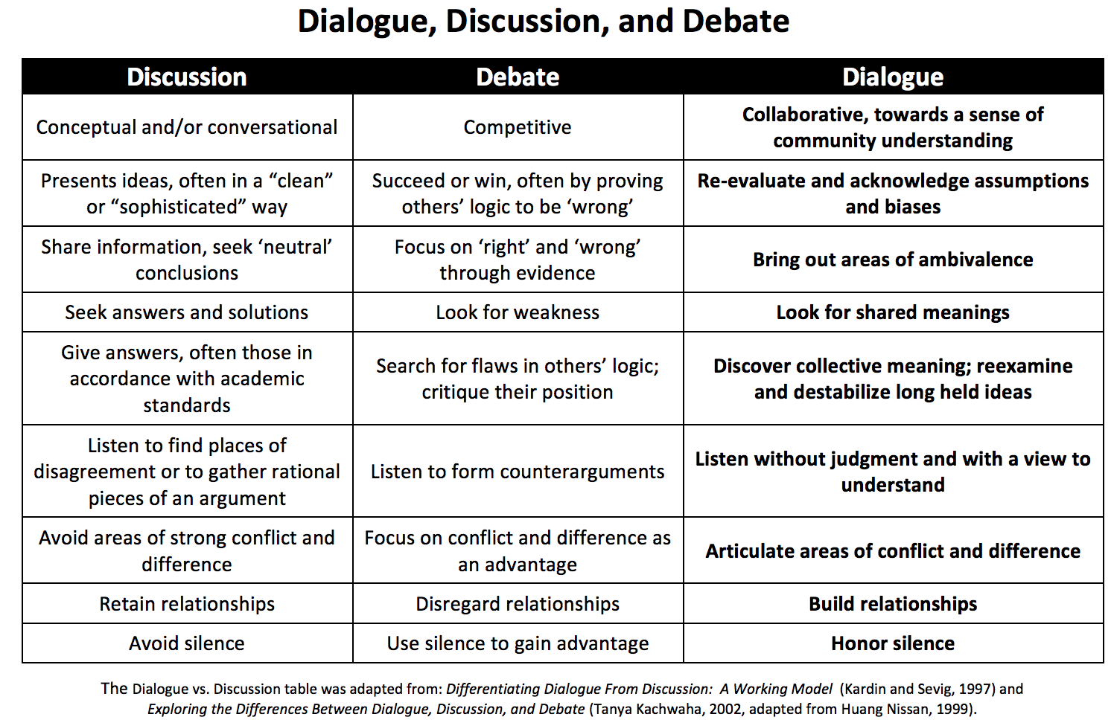

Slide 8
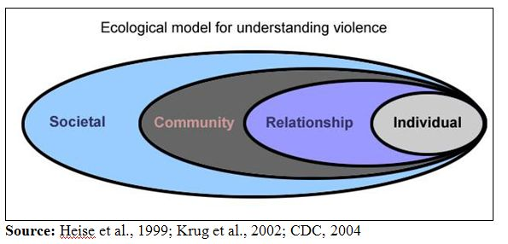
4 Corners Dialogue
Discuss the question in the corresponding corner.

Slide 9
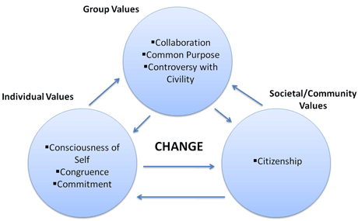
Social Change
Boudon, R. (1974). Education, opportunity, and social inequality: Changing prospects in western society.

Slide 10
Harmonizing Motivations
Three easy steps to harmonizing motivations:
Recognizing the ways in which we are individually violent towards each other, communities, and part of systems of violence. Leave them at the door.
Be open to dialogue.
Draft a solution everyone is okay with.

Slide 11
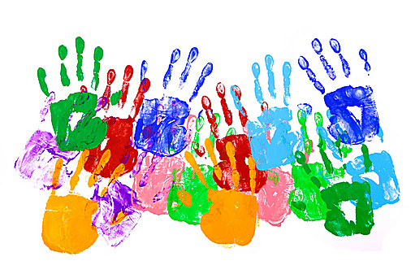
Human Rights
Human rights are rights inherent to all human beings, whatever our nationality, place of residence, sex, national or ethnic origin, color, religion, language, or any other status. We are all equally entitled to our human rights without discrimination. These rights are all interrelated, interdependent and indivisible.
Source: www.ochr.org

Slide 12
Human Rights
Activity
In groups of 5 or less decide on 4 human rights that you feel are essential for a better world. And harmonize motivations to co-create one. You should have five total after you are done.

Slide 13

Commitments…
Take a moment to reflect on what you have learned today and write down one commitment social justice as a result of it.
Carlsmoore.phd@gmail.com

