Slide 1
Dynamic Skill Integration Program
or
FLOURISH
created by Julie M. Geredien
Mindfully Integrating Skills for Conceptual Reflection, Science and the Arts
to Support Deeper Learning
and the Ways of Peace
Nurturing Civil Behavior, Moral Discernment, and Creative Potential
to Allow Learners to Flourish
and to Prepare Them to be World Citizens

Slide 2
What is The Dynamic Skill Integration Program or FLOURISH?
A research program to study effective curriculum and methodologies for World Peace Schools.
An after-school enrichment program serving ages 7-14 to be held on Monday, Tuesday and Wednesday afternoons at David J. Harris Center in Robinwood Public Housing.
An inclusive opportunity for children, volunteers, educators and artists from the community to experience a learning environment that supports the moral and spiritual foundation of education.
A curriculum that deepens and enriches mainstream educational learning, integrating skills necessary for: learning in the advanced branches of knowledge, a dynamic inner life and a vibrant society.

Slide 3
Why the name FLOURISH?
Flourishing is:
  expressing one’s true nature and given capacities with enthusiasm, dignity and increasing skill.
  bringing joy and harmony to the world as one feels oneself serving optimally in the betterment of society.
The name FLOURISH reminds us to elevate our expectation of human potential and human nature and to focus on the necessary goal of optimal development for all.
The name reminds us to devote whole-hearted attention to creating the conditions for physical, intellectual, emotional, social, moral and spiritual thriving to emerge.

Slide 4
What are key components of the Dynamic Skill Integration Program or FLOURISH?
The curriculum focuses on the guided comprehension of fables, world wisdom stories, learning stories and direct instruction within the world’s major religions, and inspiring human narratives found within literature, film and music.
It prioritizes the ecology of the learning environment, the principles of harmonious design and the sanctity of feeling within human social-emotional relationships.
It places emphasis on engaging and respecting the writing process and on instruction and practice of the National Speaking and Listening Standards
and integrates active learning in basic brain anatomy and mindful self-monitoring to provide students with the inner resources required for life-long learning and self-respect.
It offers learners the opportunity to integrate higher-level habits of mind and patterns of moral decision-making as they participate actively in food science projects and original independent and group art projects.
It celebrates higher-level, abstract, creative thinking skills and nurtures the love of service and beauty by cultivating natural attunement with reverential, proportional emotions, such as gratitude, humility, and attentive appreciation, as well as with shared communal emotions of joy, delight and wonder.

Slide 5

Participants will:
Apply knowledge of prefrontal cortex to self-guide the development of focus and attention
Apply understanding of emotions to develop empathy, compassion and learned optimism
Apply critical thinking and reflection to infer universal themes, to recognize meaning within patterns, and to guide the micro-development of moral reflection when reading, viewing, hearing or remembering a story.
Apply compassionate insights, ethical creativity and mindfulness skills to produce original writing, art work and live community performances that awaken curiosity, acceptance, inspiration, and enlivening argument.
Develop the knowledge and the inter-coordination of skills to think and behave scientifically when exploring food science and apply the principles of moral and spiritual well-being when relating to food.

Slide 6
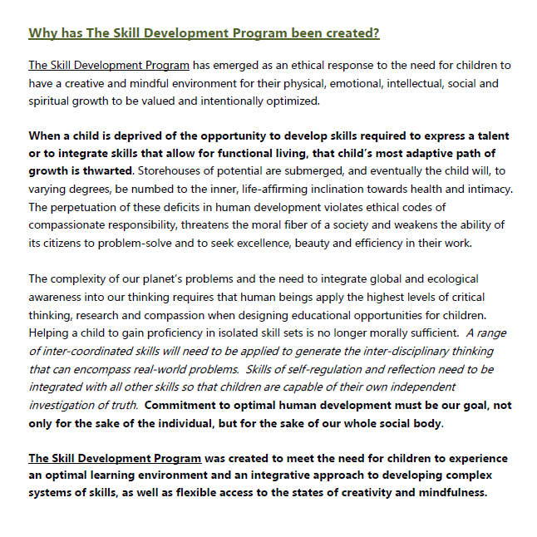
Curriculum Philosophy for Dynamic Skill Integration/FLOURISH Program

Slide 7
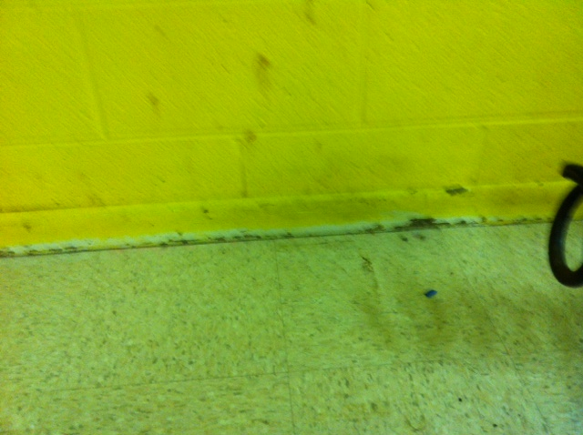
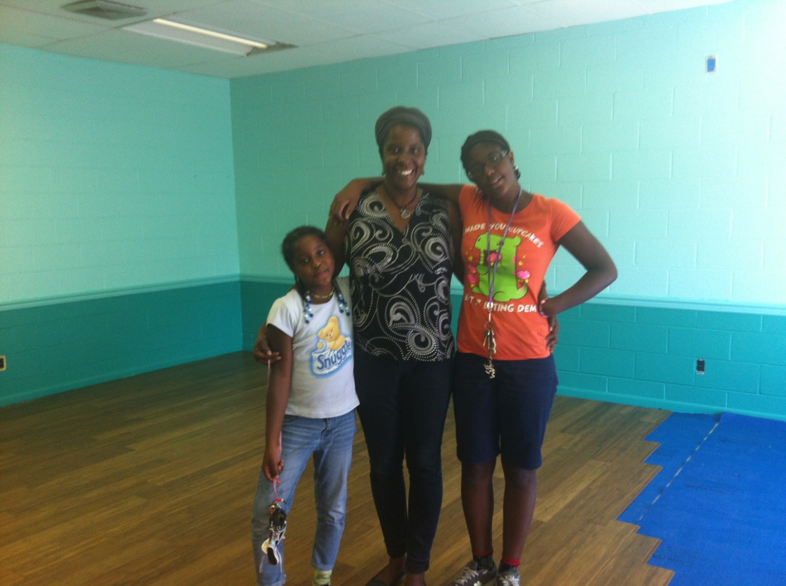
FLOURISH is built on the belief that caring for our environment and relationships best supports and nurtures mindfulness, creativity and trust
Our new sustainable bamboo flooring and environmental paint with generous support from Amicus Green Building Supply. April with two of her children, Nina and Joneice. Children and community members participated in design and restoration of the room.
Tile and wall from former Head Start room, defunct for ~ 8 years.

Slide 8
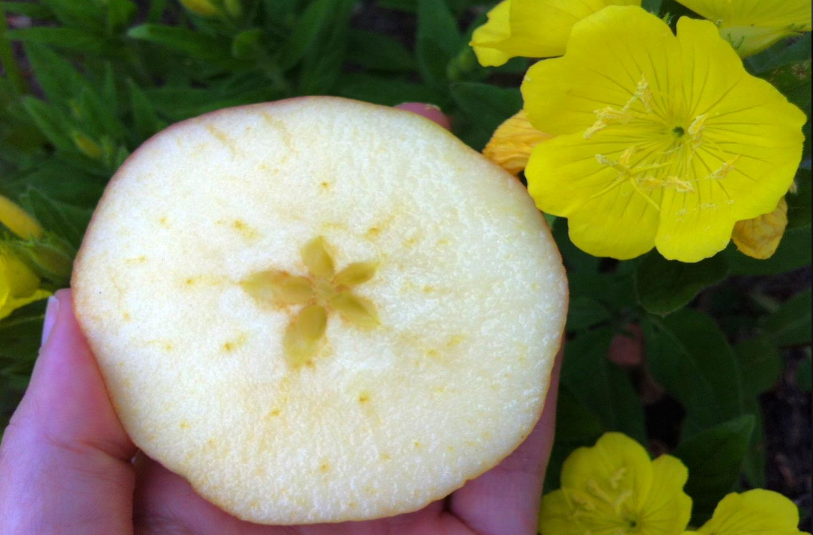
The FLOURISH program will uplift the world of being and activate the world of good-doing.

Slide 9
Note on human resources
The program seeks especially to gather and integrate the community of retired teachers to elevate their outstanding ground of collective wisdom and experience and to elevate the possibilities for continuing to learn in new dynamic and collaborative ways with them.
It also seeks to recognize, integrate and to develop the gifts of teachers and potential teachers from within the central parent schools of the children.

