Slide 1
Community Building and Crisis

Slide 2
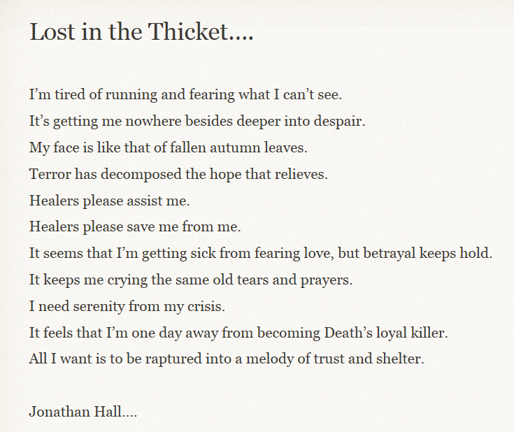

Slide 3
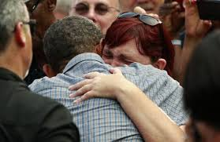

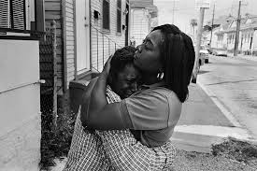
“all I want is to be raptured into a melody of trust and shelter”

Slide 4
Main purpose of talk today
is to help you to see how
community building
relates to
crisis
HOW DO THE TWO RELATE?

Slide 5
Let’s start with a simple IDEA that we know from life to be true--
community
often arises
spontaneously
from
crisis

Slide 6
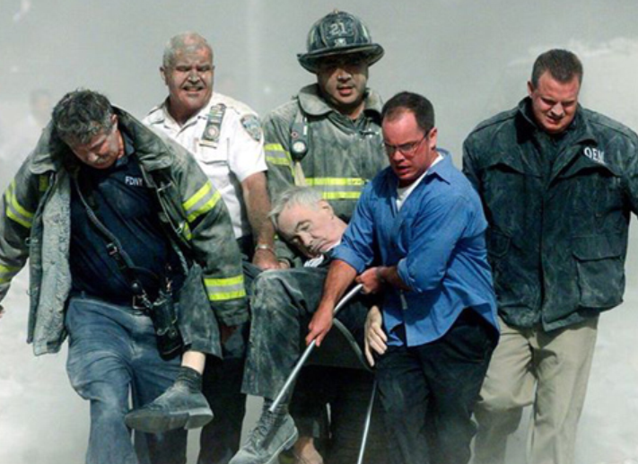
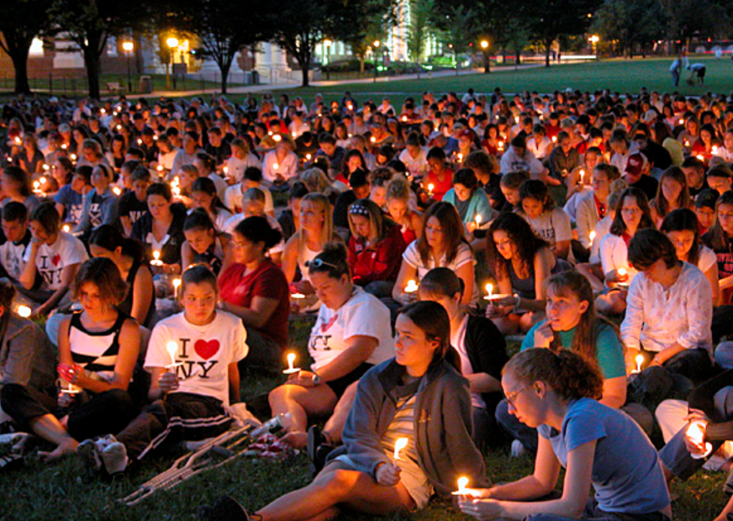
Community Response Arising from Crisis
Think about examples of ‘sticking together’ after:
9/11
Death of loved leader or local tragedy
Environmental emergency
Serious airport delay

Slide 7
Crisis and Community
“Genuine communities of a sort frequently develop in response to crisis. Strangers in the waiting room of an intensive care ward suddenly come to share each other’s hopes and fears and joys and griefs as their loved ones lie across the hall on the ‘critical list.’”
from The Different Drum, by Scott Peck, p. 77.

Slide 8
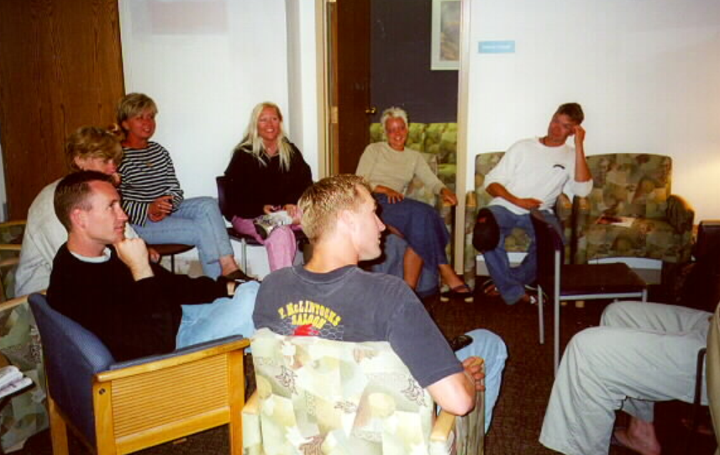
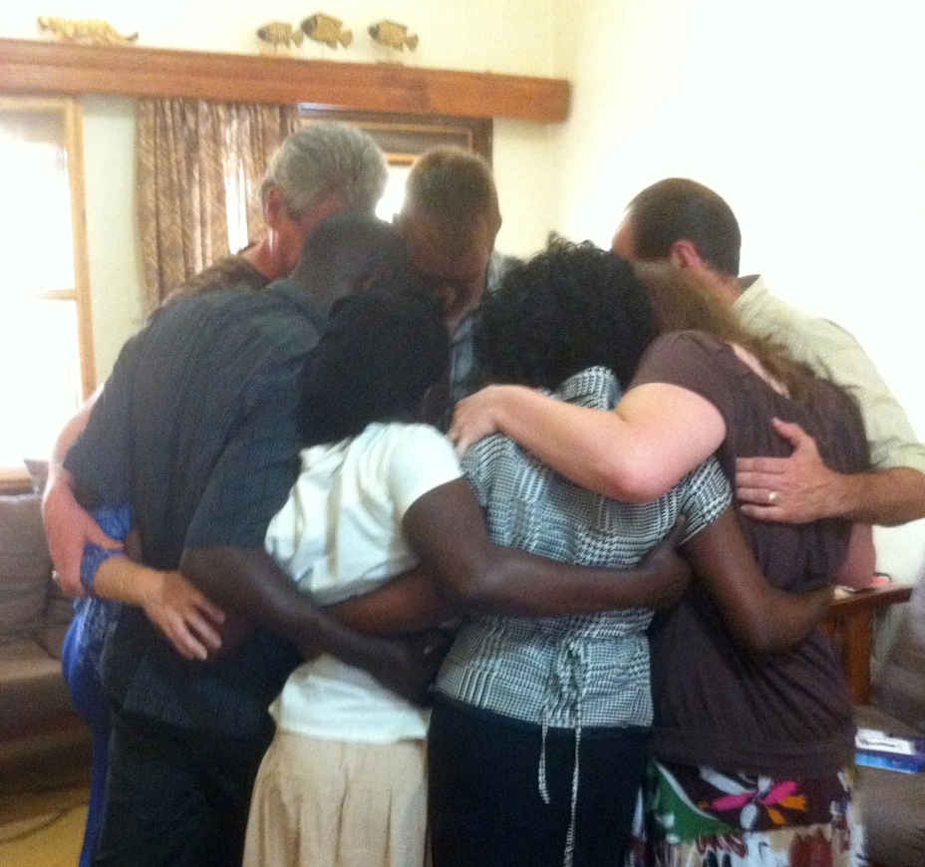

Slide 9
A THOUGHT--
crisis
is a call for
community

Slide 10
A FURTHER THOUGHT--
crisis
and
community
seem to be related
on a deep
biological level

Slide 11

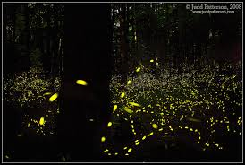
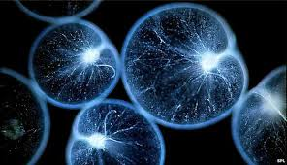
ExaExample:
to meet a crisis in survival, certain kinds of bacteria, unite and bio-luminesce to find new capacity collectively
Responding to crisis dynamically allows whole new evolutionary levels of capacity to emerge on a new integrative level.

Slide 12
A NEW THOUGHT-
crisis could be :
a point of pure life, raw experience, truth, vital pain of birthing
an emergent Reality that is not planned or controlled
a cry for new learning and integration– for a new ability, skill in relating, knowledge or capacity

Slide 13
crisis
could be
a call for
community

Slide 14
Outcome– what I hope you will leave understanding
1. How the vision and principles of Community Building provide us with an uplifted path to Crisis Intervention.

Slide 15
Outcome– what I hope you will leave understanding
How your work with crisis may reveal a higher purpose, calling, or source of vitality in your life.

Slide 16
Preview of talk
Discuss transformed way of thinking about Crisis.
Discuss transformed way of thinking about Community Building.

Slide 17
Part 1-
A Transformed Way of Thinking about Crisis

Slide 18
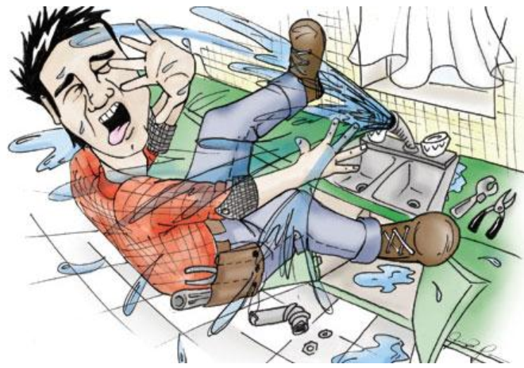
Crisis as Chaos
The Judgment= it’s negative, bad!
a rupture
an immediate danger
a disturbance of the familiar or norm
raw life experience
unplanned– needs to be controlled, fixed

Slide 19
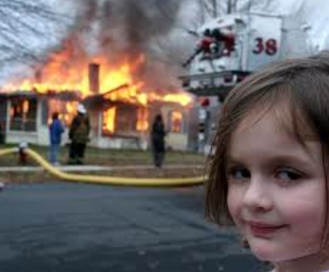
Crisis as Chaos
an emergency–
like a fire
a chaotic reality
that needs to be extinguished
feels
not functional
desperate and needy,
like ‘learning the hard way’

Slide 20
large scale social crises
intensify
individual experience
of crisis as chaos
Housing crisis
Energy crisis
Environmental crisis
Financial market crisis
Crisis in the educational system, prisons, etc

Slide 21
what do we do?
STATUS QUO—BACK INTO THE BOX--
Organize the chaos
Get things to look and sound better
Conform to ‘regular’ expectations of everyday life
‘go back to normal’
FIX AND REPAIR THE ‘DAMAGE’

Slide 22

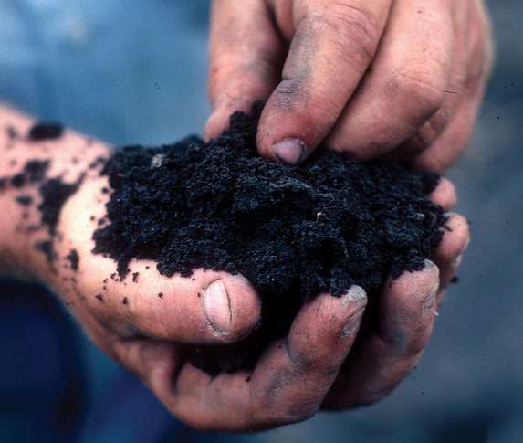
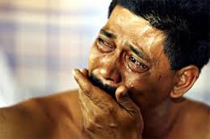
but
no deeper creative
transformation
occurs
the opportunity for new realization
and self- understanding
is missed
the life source potential
of crisis
is not responded to
there is no ‘conversion’ experience
no new way of relating to life
that springs from new insight,
discovery, deep within
when we push life
‘back into the box’
we close off
real healing
and ‘hands-on’ change

Slide 23
let’s move from thinking of crisis as chaos
to understanding crisis as CATALYST…

Slide 24
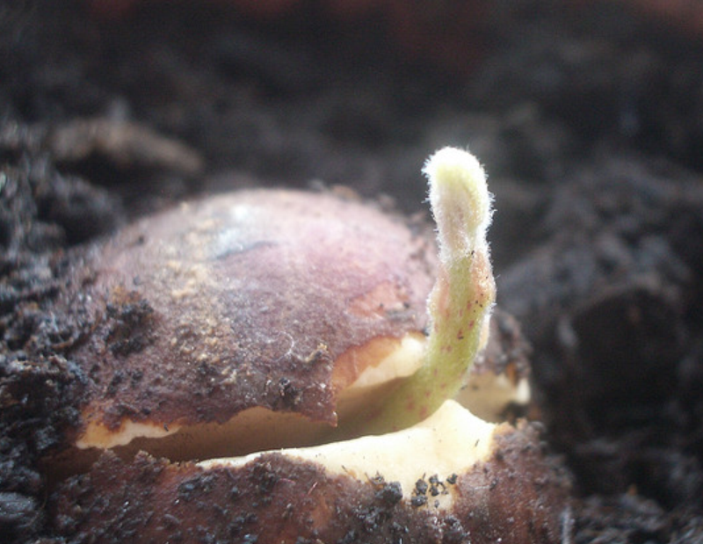
crisis as catalyst
for creative transformation
at a deep structural level
a growth point
an emergence
brokenness
and an opening
a frustration level
or vulnerability
a point of pain
that seeks new consciousness
that asks for our care
attention and focus
for light and fertile ground
WHEN we put attention on crisis and HOW we put attention on crisis create a range of possibilities for the
degree of transformation that may occur

Slide 25
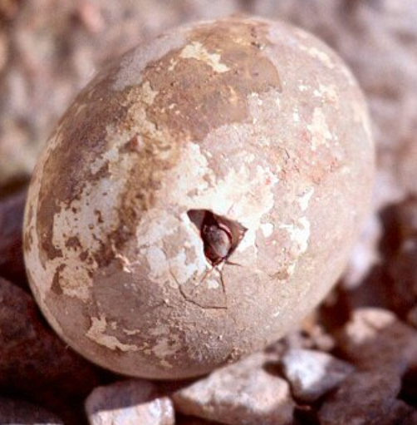
consider crisis as a point of emergence, not just as an emergency

Slide 26
Let’s explore the idea of crisis as catalyst for transformation by considering two aspects of approaching crisis that are ignored in the ‘fix and repair’ model.
To illumine these two aspects to you, I am going to give you:
1 insight from the field of READING
1 insight from the field of YOGA

Slide 27
1. AN INSIGHT FROM READING
A reader is assessed to be at ‘frustration’ level when they miss a certain number of words in a timed reading and cannot comprehend the meaning of the words they have read.
The frustrated reader is in a state of crisis when they read– especially if they are in a standardized educational system and are deemed to be ‘below grade level’ in their ability. Set materials will always be ‘too hard’ for them.

Slide 28
1. AN INSIGHT FROM READING
How does the frustrated reader move out of crisis and to a new level of ability?
The transformational reading interventionist must create CONDITIONS for new skills, knowledge, capacities to emerge, so that the reader can move out of frustrated crisis into instructional and independent levels of ability.

Slide 29
1st INSIGHT
to move out of crisis
or frustration
we need to create
CONDITIONS
for new learning to emerge–
new skills
knowledge
capacity
like a loving teacher
we can build the trust and commitment
required
to change struggle and confusion
into flow and new knowledge

Slide 30
2. AN INSIGHT FROM YOGA
Many people think yoga is ‘about’ relaxation
or feeling peace with life.
Here is a great insight from a teacher:
‘ Yoga is about being in a
functional relationship with pain.’
It is about a willingness to create a curious, open, accepting, loving mind that approaches the reality, the pain or dullness in our body and breathes into it mindfully.

Slide 31
2. AN INSIGHT FROM YOGA
In Yoga, we do not avoid or deny pain, but we also do not dominate over it
or try to ‘push’ through it.
Yoga is about an approach and gentle integration mindset to pain. We acknowledge and approach what is real and present within us and around us.
By doing this, we have opened the path to truly transforming it!

Slide 32
2nd INSIGHT
to transform
crisis
requires our willingness
and kind INTENTION
to move toward the truth
even if it is painful or challenging
like an artist
or yogi
we can transform pain
into beauty
and enlightened hope

Slide 33
A DISCOVERY
crisis as catalyst
for transformation
allows us to see
possibility and health
in crisis
“Moreover, there is a profound although little understood reality of psychological health. Contrary to what many might believe, the healthy life is hardly one marked by an absence of crises. In fact, an individual’s psychological health is distinguished by how early he or she can meet crisis.” p. 79, The Different Drum by Scott Peck

Slide 34
A SUMMARY
WHEN we look at crisis and HOW we place our attention on painful realities is related to how prepared we are for meeting the challenges of life on many levels.
Being able to face deeper truths, to be broken, to be vulnerable, is part of the gift of working with crisis– it gives us our growing point out of what is old, rigid, needs to die and change–
such as old social rules, habitual ways of relating, toxic environments.

Slide 35
A SUMMARY
understanding crisis as catalyst
we move beyond
the ‘fix and repair’ model
that we find in crisis as chaos
When we view crisis as catalyst we move towards genuine health and we understand:
the need to create loving CONDITIONS for new knowledge and capacities to emerge
2. the need for kind INTENTION to approach the truth and pain of crisis rather than avoiding it or covering it over with judgments and protocols

Slide 36
Part II—
A Transformed Way of Thinking about Community Building

Slide 37
“In our culture of rugged individualism– in which we generally feel that we dare not be honest about ourselves– we bandy around the word ‘community.’ We apply it to almost any collection of individuals– a town, a church, a synagogue, a fraternal organization, an apartment complex, a professional association– regardless of how poorly those individuals communicate with each other. It is a false use of the word.” p. 59, The Different Drum, by Scott Peck

Slide 38
What most people call ‘community’ could actually be more accurately understood as ‘pseudo-community’.
In pseudo-community, conflict and deeper questioning is avoided.
We hold on to familiar expectations, norms and social role boundaries.
We chose to ignore a range of true feelings, factual realities, and creative ideas for necessary growth that lie under the surface of human relationships.

Slide 39
Unless there is a conscious intention to create genuine community, most of our social groupings that we call community are more accurately understood as pseudo-community.

Slide 40


But what IS a genuine community?
That is impossible to say in one sentence, because genuine community is more than the sum of its parts.
The more that makes community is something mysterious.
we can explain things
that are smaller than us
but not things
that are bigger than us
For example, as Scott Peck says, an electrical engineer may be able to explain all the little parts that make up a handy little electrical space heater. But that electrical engineer will never be able to explain electricity itself. We can know the physical laws of electricity, but never the depths of its mystery.

Slide 41
Genuine community is the same way.
It is more than the sum of its parts.
We can call upon analogy to help us though, and compare community to a multifaceted gem, ‘each facet a mere aspect of a whole that defies description.’ quotes from p. 60, The Different Drum

Slide 42

These are some of the most salient characteristics of a true community:
~INCLUSIVITY, COMMITMENT, AND CONSENSUS
~REALISM
~CONTEMPLATION (AND SELF-HEALING)
~A SAFE PLACE
~A LABORATORY FOR DISARMAMENT
~A GROUP THAT CAN FIGHT GRACEFULLY
~A GROUP OF ALL LEADERS
~A SPIRIT

Slide 43
INCLUSIVITY, COMMITMENT, AND CONSENSUS
great enemy of community is exclusivity
groups that exclude are cliques, not genuine community
genuine communities have a commitment to include
with inclusion comes new group norm of consensus, not ‘top-down’ decision-making or rule by dominant judgments

Slide 44
REALISM
Because it’s inclusive, many view points are represented– brings you closer to reality
Exposure to different views gives understanding of the whole of a situation– this makes us realistic
Incorporates range of emotion, sacred and profane
Conclusions are well-rounded
Groups become more humble– they face what is larger and more complex
More humble= more realistic

Slide 45
CONTEMPLATION and SELF-HEALING
Humility is conducive to deeper thinking and reflection.
The group examines itself– self-aware
Increases awareness of inner world, outer world and relationship between the two
Members are thoughtful about the group itself
“How are we doing?”– checking in
A contemplative body– recognizes when it is getting ill
Takes action to heal itself

Slide 46
A SAFE PLACE
Single most common expression: “I feel safe here.”
Defenses and resistance no longer needed
Thrust to genuine health is liberated
No one tries to convert, fix or change you
You are free to discard defenses, masks, disguises
Free to be whole and holy self

Slide 47
A LABORATORY FOR PERSONAL DISARMAMENT
Like a laboratory because a place designed to be safe for experiments
Experiment with new types of behavior
Drop habitual defenses and barriers– experiment with being vulnerable
Discover rules of peacemaking- learn its virtues
Can be inspiration for quest for peace on global scale

Slide 48
A GROUP THAT CAN FIGHT GRACEFULLY
There are no sides
Members give up cliques and factions
Learn how to listen and not reject each other
Consensus may be quick or a struggle, but people stay with it as a matter of principle
Genuine community DOES have conflict, but it is a place where conflict can be resolved
No physical or emotional bloodshed –instead, wisdom as well as grace.

Slide 49
A GROUP OF ALL LEADERS
Referred to sometimes as ‘leaderless groups’
A community is actually a group of all leaders
Compulsive leaders feel free in community to not lead
The shy feel free to step into latent gifts of leadership
The result -- an ideal decision-making body
Traditional hierarchical patterns temporarily set aside
It is the spirit of community itself that leads and not any single individual.

Slide 50
A SPIRIT
Not a competitive spirit--"Our town is better than your town"
Community is a spirit – of peace
A dramatic change
Palpable
Struggle now takes place on a ground of love, not fear and fear-based power
Wisdom of a true community often seems miraculous
As if heaven and earth had somehow met
The gate to genuine social transformation is opened

Slide 51
In this multi-faceted, whole way of seeing GENUINE COMMUNITY, we understand that the community building process protects the gifts of CRISIS. In community, we can partake of the source of life that cries from within the truth of crisis--
we can drink
from a wellspring together–
we can experience
a conversion
through love and tears
we can know
the promise
of our human resilience

Slide 52
TWO ESSENTIAL ELEMENTS of GENUINE COMMUNITY
CONDITIONS for growth are protected.
Individual members agree to abide by the principles that allow new skills, knowledge and capacities to emerge – the guiding ecological laws of community are sustained because they are stated clearly from the beginning; honoring them throughout the process is always a first priority.
INTENTION to reach a new ‘summit of understanding’ together is shared.
This is established from the outset. It is this willing sense of purposeful mission that creates a challenge and encourages the healthy emergence of crisis. Crisis is transformed as members struggle and surrender to bring the new reality of genuine community into existence. Through this intention the group is able to apply integrity as they ‘weather the storms’ in communication.

Slide 53
As you can see, our everyday common understanding of community is much different from the intention, design and beauty of GENUINE COMMUNITY.
We live in a world of pseudo-community, where crisis is felt as chaos…but with right conditions and intention, we can build genuine community, where crisis is understood as a catalyst of transformation.

Slide 54
On Thursday–
Learning More About Community Building
What does genuine community feel like?
What are the stages in the community building process?

Slide 55
Julie Geredien
732-763-0871
Community Building AACC Campus Group
Upcoming 2015 Summer Course:
The Axial Moment: Exploring Individual and Social Transformation

