Slide 1
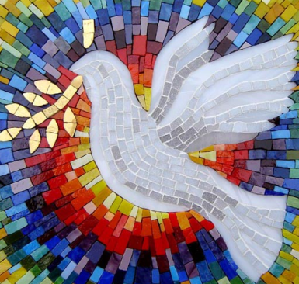

Meeting 6
The Relationship Between
World Citizenship and
Local Participatory Democracy and
Civic and Creative Arts Renewal

Slide 2
Compare and Contrast– Role of Religion in Unifying Vision of Democracy
Billy Graham
Martin Luther King

Slide 3
6. Group Discussion
How is vision of democracy transformed when friend/enemy split becomes acceptance of universal love and true friendship?
How does the way King awakens patriotism differ from the way Graham does?

Slide 4
1. Theme and Opening Questions
What is a World Citizen? How is the world citizen both practical and realistic, how is the world citizen a true idealist and visionary, how is the world citizen helping to ‘give birth’ to a new world?
Why does World Citizenship require an awakened appreciation of our subjectivity and of the potentialities of the universal, plural self within us?
How is World Citizenship a political expression of universal love? What are the actions and manifestations of this love in a New World Order of Peace and Justice?
What are the ‘terrors of globalization’ and how does an ecological movement of localization serve to counter its spread and to encourage qualities of engaged citizenship?
What is a participatory democracy, what are its modes of relating and of action, how is it different from present constructions of democracy that are powered by money and party identification?
What are infrastructures that support both World Citizenship and local community flourishing?

Slide 5
2. New Concepts and Vocabulary
Common Faculty- common knowledge

Slide 6
Qualities and Values within the Social Body
Globalization New World Order
Neo-liberal market grid Middle Way, River of Being
Fragmentation Harmonization
Homogenization Diversification
Fungus Kingdom Plant Kingdom
Fungibility Transpiration
Commodified Space Body~Place~Commons
citizen as consumer ecological citizen

Slide 7
Qualities of the Citizen and Ways of Relating
Subject of the State Subject of Mystery Omniscience, Most Great Spirit, God, Truth
Passivity Engagement
Consumption of society Creation of society deep reflection & action tendency
Green-washing Compassionate
white-washing Confrontation
status quo ‘polite’ civility transformative perception and agreement
Pseudo-community Genuine Community

Slide 8
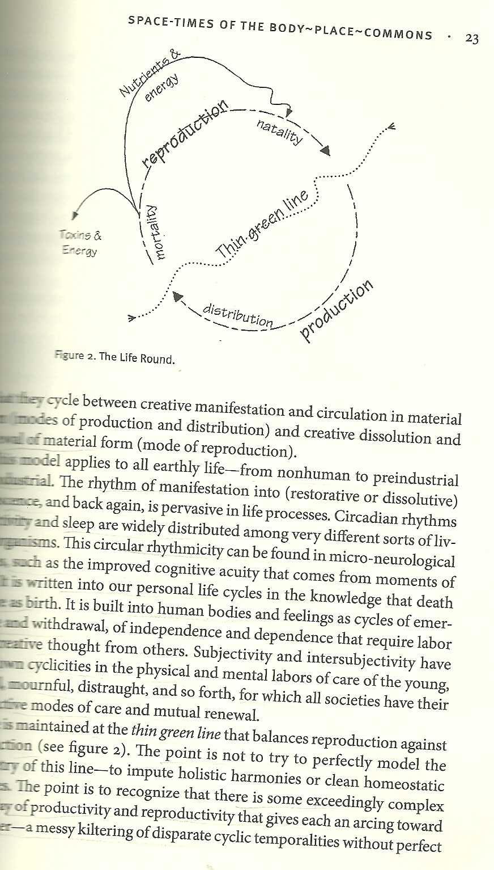
Concepts Related to Claiming a World-in-Common
‘Replacing space with time’
‘Re-scale temporal and spatial being’
FULL LIFE ROUND
  ‘Art should imitate nature in its mode of operation not in its natural appearances.’

Slide 9
Concepts Related to
Birthing a New World Order of Peace
Nascent ‘imaginarius’
Idealism, the Faithful Lover archetype, Paradise of Perfection
Trustworthiness- Neural Pillars of Wisdom– Human Security

Slide 10
Concepts Related to
Outcomes and Actions
Utopianism Practical spirituality
positivism, optimism realism, unified body
Externalization Integration
‘black box’ decisions inclusive, integrity decisions

Slide 11
Concepts Related to
Individual and Social Transformation
Regenerative Emotions
Communal Lament
Cognitive Accomodations to Grandeur
Radical Beauty- Esthetics
Cosmopoetic play; Cosmogenesis
Unbiased Reasoning- ‘High’ Reasoning

Slide 12
Concepts Related to
New Infrastructures for Universal Democracy
Community Learning and Education
Community Making Process
Participatory Action Research
Eco-Community Mapping
Civic and Creative Arts Renewal
Interfaith Gatherings
Open Mass Communication– radio, television, film, newspaper, public announcements, street theater, music

Slide 13
3. Theme and Opening Quotes
Give us back our suffering, we cry to Heaven in our hearts—suffering rather than indifferentism; for out of nothing comes nothing. But out of suffering may come the cure. Better have pain than paralysis! A hundred struggle and drown in the breakers. One discovers the new world. But rather, ten times rather, die in the surf, heralding the way to that new world, than stand idly on the shore! (Florence Nightingale, Cassandra, 1860)

Slide 14
Consider the days of Jesus, when there was only a small body of people, and then observe the great tree which grew from that seed and what an abundant fruit it produced. This is greater than that, forasmuch as it is the calling of the Lord of Hosts and the voice of the trumpet of the living God; it is the summons unto the harmony and unison of the world, and it is the banner of faithfulness, trustworthiness and friendship among the different nations and sects of the universe; it is the light of the Sun of truth and the spirituality of the Majestic One. Verily this great cycle will encompass all the horizons and ultimately all the nations will gather together under this standard.
--Abdu’l-Baha, Baha’i Writings

Slide 15
A New Language
Oh friend
You said
We need a new language
A new sadhana of words and tapasya of worlds
This is not a language of victory
Nor is one of self-advertisement and aggrandizement
Neither is it a language of doomsday
This is a language of walking our ways together
Walking our dreams, sadhana and struggle

Slide 16
In our co-habitations of affection
Of compassion and confrontation
Words become mantras
Of a new life, a new responsibility
Of wiping tears from our eyes and
Again taking each other into our laps
Renewing our strength from embrace
We create new paths by walking
We create new language
Our language is the language of walking
Stars mantra leap from our lap
by Ananta Giri

Slide 17
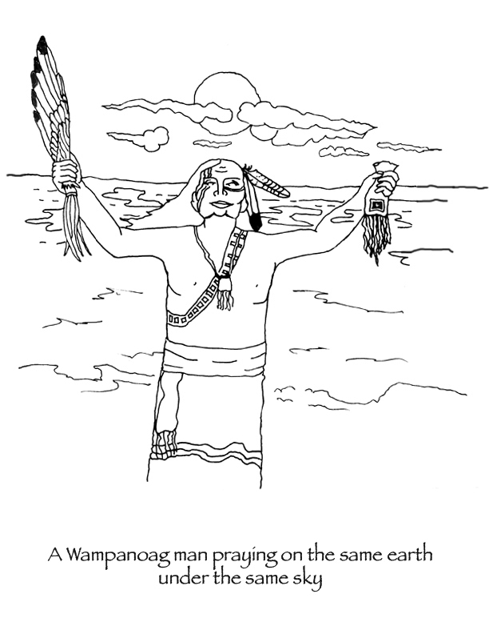
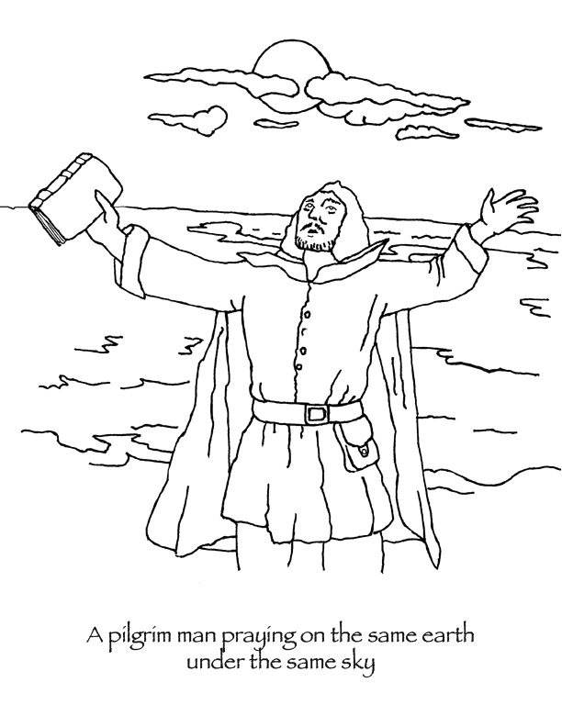

Slide 18
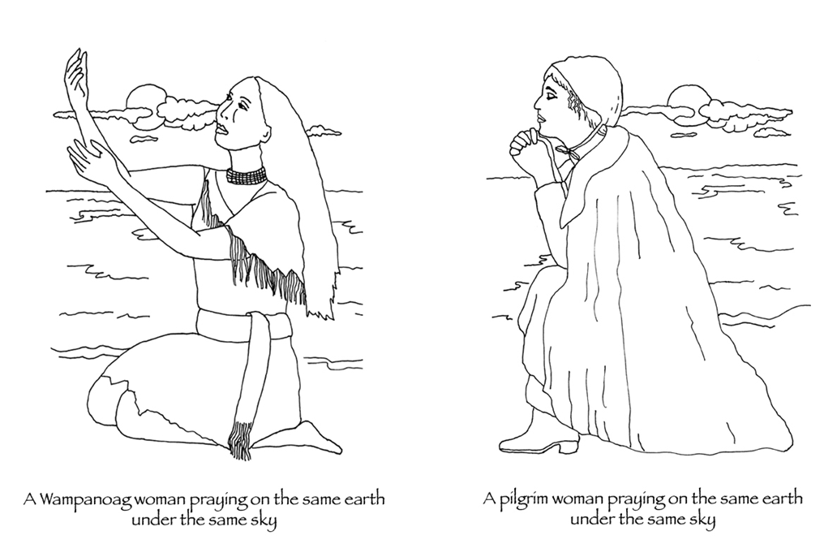

Slide 19
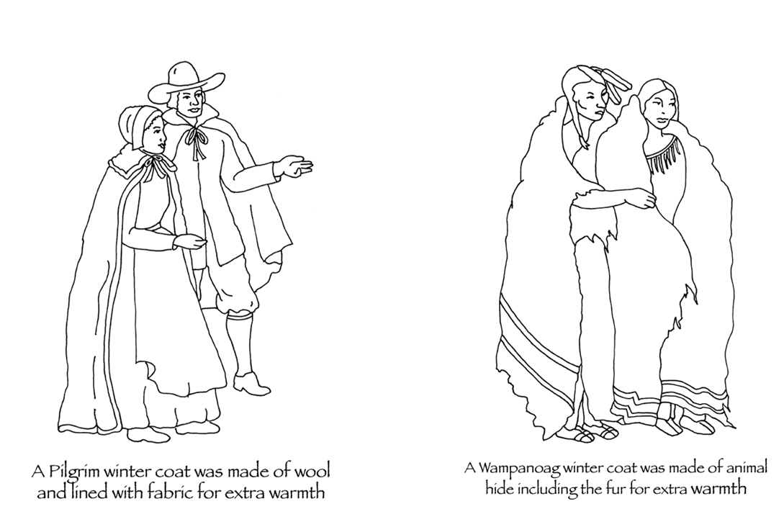

Slide 20
The Condor and Eagle ‘Prophecy’
“According to anthropologist Jeff Jenkins, the prophecy of the Eagle and Condor is within several (Andean Quechua, New Mexican Hopi, Guatemalan, Honduran and Mexican Mayan, Ecuadorian Shuar, and other) traditional indigenous cultures of North, Central, and South America. From these different regions come prophecies with a common theme of arriving to a point in time when ‘the human family would face the choice of evolutionary transformation into symbiotic presence within the more-than-human world or to continue in the destruction of the planet.’”(2)
http://www.pachamama.org/blog/the-eagle-and-the-condor-prophecy (1)
http://realitysandwich.com/146869/prophecy_eagle_and_condor/ (2)
Notes:
The Eagle and the Condor is an ancient Amazon prophecy that speaks of human societies splitting into two paths – that of the Eagle, and that of the Condor. The path of the Condor is the path of heart, of intuition, and of the feminine. The path of the Eagle is the path of the mind, of the industrial, and of the masculine. (1)
The prophecy says that the 1490s would begin a 500 year period during which the Eagle people would become so powerful that they would virtually drive the Condor people out of existence. This can be seen in the conquering of the Americas and the killing and oppressing of the indigenous peoples in the subsequent 500 years – up to and including today. (1)
The prophecy says that during the next 500-year period, beginning in 1990, the potential would arise for the Eagle and the Condor to come together, to fly in the same sky, and to create a new level of consciousness for humanity. The prophecy only speaks of the potential, so it’s up to us to activate this potential and ensure that a new consciousness is allowed to arise. (1)

Slide 21
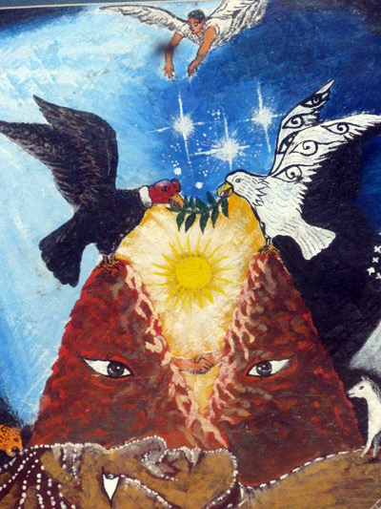
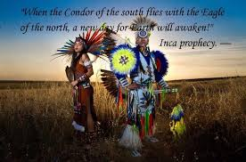
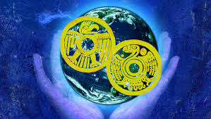
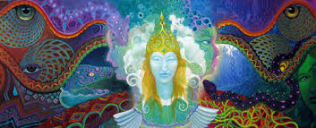

Slide 22
“I understand that the Condor archetype was symbiotic with the jungle Harpy Eagle archetype prior to European conquest. They soared together in both jungle and mountain terrain through the lands. The concepts of north and south and their respective archetypal and geographical resonance became clearer through subsequent centuries, when the symbol of the bald eagle became the dominating force of USA orchestrated mass genocide of the indigenous peoples.
The indigenous condor consciousness was seen as inferior. The regenerative efficiencies (harvesting carrion and bringing back the energies of the dead) of the condor’s ways were disregarded.
Symbolically and literally, the condor began its journey through torturous endangerment to the brink of extinction. The associations of north and south were, if I understand correctly, emergent and co-arising with the expanded intricacies of the way history panned out in the north and south.” (2)
http://www.pachamama.org/blog/the-eagle-and-the-condor-prophecy (1)
http://realitysandwich.com/146869/prophecy_eagle_and_condor/ (2)

Slide 23
Body~place~commons- local ecology, intimacy, and ‘flesh horizons’
Our being is not ‘in’ us, like something poured in a bag of skin, nor is it ‘outside’ our skin in signs, economies, machines, or power. The stuff of our being arises as dynamic infrastructures of forms of life that we share with nonhuman creatures– generative matrices of co-constitution among particular bodies within the chaotic piling up of particular conditions of ecological relations within particular places. (Reid, Taylor, Recovering the Commons)

Slide 24
Body~place~commons
There is now a growing body of interdisciplinary literature (cf. Kahn, 1999; Kahn& Kellert, 2002; Goodenough, 200; Nabhan& Trimble, 1994) on the intertwining of place and human development, the child’s need for nonhuman nature, and the reciprocity of place and person in experience. We fear that the contemporary possibility of understanding better than ever before the matrix or nexus of body, place, and commons is directly related to the degree to which it is threatened. But there is an emerging transnational politics especially from the grassroots level for a world-in-common that finds its life-ground, however remnantal, here. (Reid, Taylor, Recovering the Commons)

Slide 25
“ …historically religions have had ecological dimensions in the ways they ground human communities in the rhythms of nature. This is what we are calling religious ecology.” (Grim, Tucker, Ecology and Religion)

Slide 26
Affirmation of Life and Sacralization of Place through
World Religion and
Indigenous Wisdom
Affirmation of life through Judaic Justice, Christian universalism, Taoist chi (qi) life flow, Confucian sheng-sheng, fecundity of natural world, humaneness of love- jen.
Affirmation of land through sacred communal life, symbol, ritual, religious and indigenous practices and interactions
‘Poetics of prophecy’– cyclical and synchronic time

Slide 27
GROUND OF BEING, REGENERATION, CREATIVE BIRTHING PROCESS
“We’ve got to go underground therefore, like seed, so that something new something different, may come forth. It isn’t time that’s required it’s a new way of looking at things.
Night –season. I think that is a lovely phrase.”
--Terry Tempest Williams, Finding Beauty in a Broken World, 70)

Slide 28
POETICS OF DEVELOPMENT
Poetry [..] can be seen as an event with performative force, words which open up this contact, make something manifest for the first time. But what is this event?
Outside of the most subjectivist interpretations, it has an objective side: something language-transcendent is manifested, set free.
But it also has an inescapably subjectivist aspect. This reality is made manifest to us, who speak this language, have this sensibility, have been prepared by previous speech or experience. So this new word resonates in / for us; that the word reveals what it does is also a fact about us, even though it is more than this.
It could in principle resonate for everyone [..] It opens new paths, ‘sets free’ new realities, but only for those for whom it resonates.
Charles Taylor (2011), “Celan and the Recovery of Language,” p. 59-60

Slide 29
NEW VISION HUMAN LIFE
AND PROGRESS
The liberation of science and religion would open the way to a profound cultural turning from which economic and political turnings naturally follow. As humans come to embrace the truth that we are all creatures of the one living, immanent Spirit, competition for dominator power of one over another becomes an anachronism. Gratuitous violence becomes sacrilege. The pursuit of money beyond reasonable need becomes idolatry. Chauvinist exceptionalism becomes a mark of emotional immaturity.
—David C. Corten (2006), The Great Turning: From Empire to Earth Community, p. 265

Slide 30
NEW VISION OF
INDIVIDUALITY AND POLITICS
“The new movements demanding global democracy not only values the singularity of each as a fundamental organizing principle but they also poses it as a process of self-transformation, hybridization, and miscegenation.
The multiplicity of the multitude is not just a matter of being different but also a becoming different. Become different than you are! These singularities act in common and thus form a new race, that is politically coordinated subjectivity that the multitude produces. The primary decision made by the multitude is really the decision to create a new race or, rather, a new humanity. When love is conceived politically, then the creation of a new humanity is the ultimate act of love.” (Hardt and Negri 2004, from Multitude, 358)

Slide 31
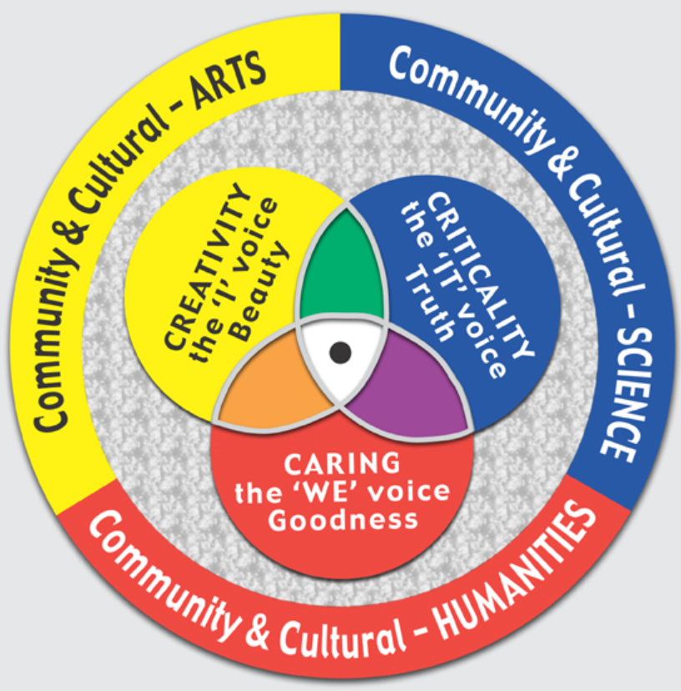
BECOMING REAL FAMILY,
BECOMING REAL CITIZENS
What is helpful is that both the traditions of cosmopolitanism– of citizenship and of human family– work with images of concentric circles. Now, this needs to be supplemented by a vision and practice of overlapping circles.
(Giri , Knowledge and Human Liberation, 297)
From SunWALK holistic educational model by Dr. Roger Prentice

Slide 32
BECOMING REAL FAMILY,
BECOMING REAL CITIZENS
In this area of emergent transversality, our vision and practice of being a cosmopolitan is that of being a citizen of the world as well as member of the human family. Such a multi-dimensional self-conceptualization and institutional figuration of cosmopolitanism would help us overcome the limitations of both polis and family, open them to mutual critique and transformation, and inspire them to embody a multivalued existence of autonomy, interpenetration and responsibility.
(Giri , Knowledge and Human Liberation, 297)

Slide 33
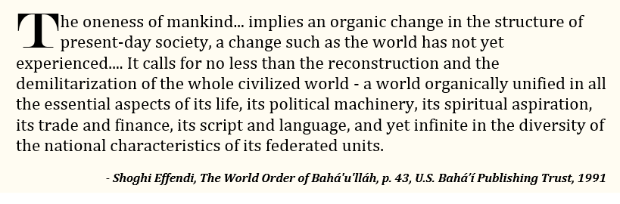

Slide 34
Reflection Questions
How does the ‘overlapping consensus’ of our equality, relatedness, and capacity for peace, found within world religion and indigenous teaching, lead us to practical, political action as World Citizens?
How is World Citizenship a transformative act of birthing that involves co-suffering?
Why do we need to awaken the common faculty?
How is an appreciation of body~place~commons a natural antidote to globalization and a necessity for true World Citizenship?
How does an embrace of the Subject allow us to become ‘different’? Why do we need to claim our diversity?

Slide 35
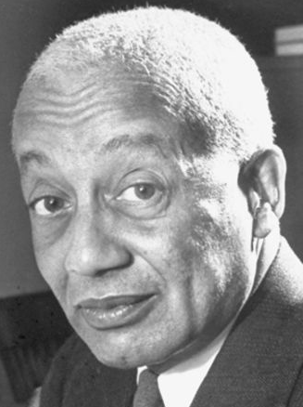
4. Direct Instruction
PART I: Alain Locke and Emergent Practical Understandings of the World Citizen
http://www.biography.com/people/alain-leroy-locke-37962
http://christopherbuck.com/pdf/Buck_2008_Locke_World_Order.pdf
http://bahaiteachings.org/wp-content/uploads/2014/07/Buck_2014_Locke_World_Citizenship_Edit.pdf
http://bahai-library.com/pdf/b/buck_locke_faith_philosophy.pdf
- on line full book about his life, philosophy and Baha’i universal values

Slide 36
ALAIN LEROY LOCKE
Early Life and Education
Alain LeRoy Locke was born in Philadelphia, Pennsylvania, on September 13, 1886, to father Pliny Ishmael and mother Mary Hawkins Locke. A gifted student, Locke graduated from Philadelphia's Central High School second in his class in 1902. He attended the Philadelphia School of Pedagogy before matriculating at Harvard University, from which he graduated in 1907 with degrees in both literature and philosophy.
Despite his intellect and clear talent, Locke faced significant barriers as an African American. Though he was selected as the first African-American Rhodes Scholar, Locke was denied admission to several colleges at the University of Oxford because of his race. He finally gained entry into Hertford College, where he studied from 1907 to 1910. Locke also studied philosophy at the University of Berlin during his years abroad.

Slide 37
ALAIN LEROY LOCKE
Connecting Artists with Place and
Inspiring the Harlem Renaissance
Locke promoted African-American artists and writers, encouraging them to look to Africa for artistic inspiration. Author Zora Neale Hurston received significant support from Locke. He also reviewed the work of African-American scholars in the pages of the periodicals Opportunity and Phylon, and published work on African-American art, theater, poetry and music.

Slide 38
ALAIN LEROY LOCKE
Connecting Artists with Transformative Potential of Self and Culture
Inspiring the Harlem Renaissance
Much of Locke's writing focused on African and African-American identity. His collection of writing and illustrations, The New Negro, was published in 1925 and quickly became a classic. He also published pieces on the Harlem Renaissance, communicating the energy and potential of Harlem culture to a wide audience of both black and white readers. For his part in developing the movement, Locke has been dubbed the "Father of the Harlem Renaissance."
His views on African-American intellectual and cultural life differed sharply from those of other Harlem Renaissance leaders, however, including W.E.B. Du Bois (who was also a friend of Locke's). While Du Bois believed that African-American artists should aim to uplift their race, Locke argued that the artist's responsibility was primarily to himself or herself.

Slide 39
World Citizenship: Mirage or Reality?
Address by Alain Locke
Professor of Philosophy at Howard University
May 18, 1947
Given at the regular Sunday morning meeting
of the New York Society for Ethical Culture
2 West 64th Street
New York City

Slide 40
from World Citizenship: Mirage or Reality?
Vital morality, we together agree, is the effort to practicalize the ideal, and to do that, one must spend less time in the praise and justification of morality in the abstract and more time and effort on the concrete ways and means of moral action.
And so, I pose the pragmatic question: To what extent is world citizenship possible? How realizable is this ideal, which though so peculiarly involved in the general state of our world today, is nevertheless so old and recurring an idea with all the great spiritual teachers of mankind, the religious prophets especially? Is world citizenship a mirage or can it become a reality?
As contrasted with an idealistic devotee, a realistic believer is one who carefully estimates the discrepancies and obstacles between the actual situation and its proposed ideal objectives. Let us, accordingly, take stock of what has stood and still stands between us and any considerable attainment of the goals of world citizenship.

Slide 41
PRACTICALIZATION OF
WORLD CITIZENSHIP
The “one world” of today is neither the religious concept of a world united by the spiritual bonds of a common belief nor that humanist dream of a world intellectually unified by a common tradition of culture.
Instead, the one world of today is the much more realistic notion of a world community politically united by a common loyalty to international law and justice and mutually federated by guaranteed reciprocity in communication, trade and culture.
This in itself is an obvious practicalization of the basic idea, and to that extent a real gain both in practicability and in vital relevance to the interests of ordinary men. Brought down within range of the interests and practical understanding of the average man, world citizenship has become a matter of common and vital concern. Thus far, a perspective of widened hope and enhanced reality confronts us as we contemplate the history of the idea.

Slide 42
ON THE POSITIVE SIDE-
GLOBAL INTER-COMMUNICATION
On the positive side, quite in contrast to previous
periods when men sought to propagate world fellowship,
we do in our day have possession at last of that all important
and basic factor—world communication.
Communication is so essential to community, that, in
retrospect, we can see that it was a hardy, indeed almost a
foolhardy idealism that could seriously contemplate the
practicability of world citizenship in the comparative
absence of so necessary a means to its realization.
But today we have global intercommunication, and to that extent
have no insuperable limitations to world-mindedness. Also
by the same token, we have no moral alibi for our failure to
achieve it.

Slide 43
ON THE POSITIVE SIDE-
TRADITIONAL DESIRES
FOR WORLD UNITY
Also on the positive side, we have additionally strong practical re-enforcement [sic, reinforcement] of our traditional desires for world unity coming from the new
and inescapable needs for world collaboration so characteristic of our present day. World War II and its aftermath of world reconstruction have seen to that.

Slide 44
ON THE NEGATIVE SIDE-
NATIONALISM AND
PSYCHOLOGICAL BARRIERS
But paradoxically,
just as we come into possession for
the first time of fully adequate means for world-scale living and sense, also for the first time in any clear way, its practical urgencies and advantages, we confront, on the negative side, greatly augmented obstacles, decidedly intensified hindrances to world citizenship. Indeed, world citizenship today, in the context of a century dominated by intense nationalism, faces psychological barriers of the gravest and most challenging character.

Slide 45
ON THE OBSTACLE OF EXPANSIONISM AND COMPETITIVE NATIONALISM
Our most characteristic way of life, expansionist and competitive nationalism, thus stands directly in the path of effective
internationalism and that world citizenship which is both its rationale and its practical support.

Slide 46
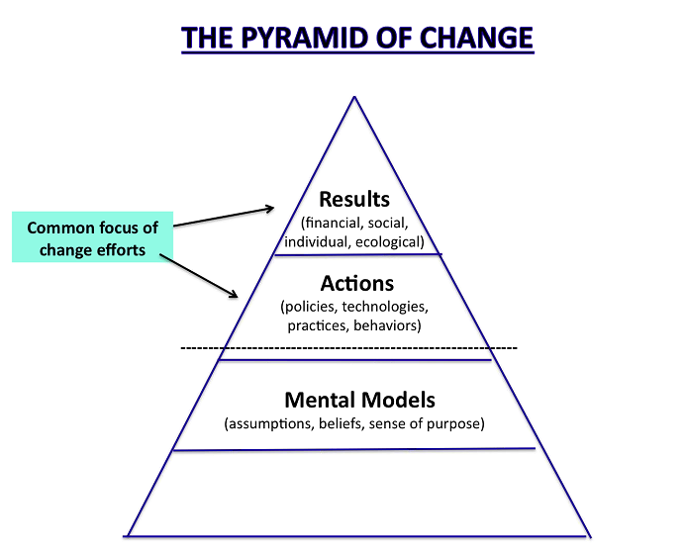
Wherefore we must conclude, if we insist on being realistic, that any substantial advance toward the objectives of world citizenship involves challenging and changing all such mind-sets as stand in its way.
From the same source stems another serious obstacle, an almost irreconcilable contradiction of true cosmopolitanism, and that is our almost chronic mind-set of cultural imperialism.

Slide 47
ON DANGERS OF CULTURAL IMPERIALISM
  This cultural imperialism, with its false identification of nationality with culture and its bigoted and tactless objectives of unity through imposed conformity, is even more insidious and divisive than its political and economic counterparts, and threatens, long even after the liquidation of empire, to raise additional barriers, difficult for constructive world attitudes to surmount.

Slide 48
Sidenote from Locke: Faith and Philosophy by Chris Buck
Pragmatism gave birth to cultural pluralism, which Locke helped originate, develop, and promulgate with almost religious zeal. During the 1920s, the question as to what constitutes American identity was “a national preoccupation.”
Posnock states that “pragmatism’s answer” was “cultural pluralism,” as opposed to the coercions of assimilation— the pressure to conform—in the American paradigm of the “melting pot.”
Cultural pluralism (known now as multiculturalism) was Locke’s philosophical faith— “a new Americanism” as he called it.
Compensating for liberalism’s fixation on freedom, cultural pluralism provides a philosophical foundation for unity in diversity by extending the idea of democracy beyond individuals and individual rights to the equal recognition of cultural, racial, and other group rights. (p. 23)

Slide 49
ON DANGERS OF GLOBALIZATION
NARROW MINDSETS
Though imponderable, we know that these barriers of thought and feeling are quite as serious as the material impediments, perhaps more serious.
For the older provincialisms were confined to comparatively narrow and natural limits, whereas these synthetic provincialisms of today have wider scope and greater divisive force. They are also more inexcusable as provincialisms with world pretensions, abortively competing in an international setting.

Slide 50
ON INTEGRITY TO THE VISION OF WORLD CITIZENSHIP
Clear and courageous thinking on the issue will see no chance for the newer values and broader viewpoints except through head-on battle with these irreconcilables.
The highest disservice, therefore, to the cause of world citizenship is to temporize with such manifest contradictions as narrow, traditional patriotism, arbitrary and irresponsible national sovereignty, militant and exclusivist cultural pride and prejudice, while at the same time giving lip service to cosmopolitanism and ideals of world understanding and collaboration. To do so is to contradict oneself, as well as to sabotage the essential next steps of social progress.

Slide 51
ON NEED FOR NEW EDUCATION
Franz Boas is even more explicit, and for that reason is additionally convincing about this necessity for enlarging the concept of the nation and revising the character of our loyalty to it. Says Boas: …
      “For this reason, I believe that the purely emotional
      basis on which, the world over, patriotic feelings are
      instilled into the minds of children is one of the most
      serious faults of our educational system, particularly
      when we compare these methods with a lukewarm
      attention that is given to the common interests of
      humanity.”

Slide 52
ON CULTURAL IMPERIALISM AND FALSE NOTIONS OF CIVILIZATION
Toynbee unmasks and censures our cultural
imperialism in short-shrift fashion. Says he:
      “We are no longer conscious of the presence in the
      world of other societies of equal standing, though
      regarding our society as being identical with
      [‘]civilized[’] mankind, viewing the peoples and
      cultures outside its pale as being mere ‘natives’ of the
      territories which they inhabit on sufferance, but which
      morally as well as practically are at our disposal by the
      higher right of our assumed monopoly of civilization.”

Slide 53
ON MOVING BEYOND
‘CIVILIZATION’ VIEWPOINT
…it has at least become obvious to many minds and hearts that no sound internationalism can be erected upon so narrow and biased a base. We must all realize that in the course of time we must recant the monopoly of civilization viewpoint or revert again to the competitive pursuits of national imperialism, with one surviving great power as the only logical solution to the professed objectives of “One World.”

Slide 54
ON DEDICATION TO UNIVERSAL FAMILY LEADING TO WORLD CITIZENSHIP
Says Boas:
    “With the advance of civilization, we see the
    groups which have common interests and in which the
    bonds of human brotherhood are considered binding
    expand until we reach the concept that all men are
    created with equal rights.
    Socrates, Buddha, and Christ are milestones which indicate
    the birth of this great idea. But the two thousand years or more
    That have elapsed since their time have not sufficed, however, to
    bring about the realization of these ideals.”

Slide 55
ON WORLD CITIZENSHIP
AND FAMILY FIRST
Based on this knowledge, it is my opinion that our first duties are to humanity as a whole, and that in a conflict of duties our obligations to humanity are of higher value than those toward the nation; in other words, that patriotism must be subordinated to humanism.

Slide 56
PART II: LOCAL CIVIC AND CREATIVE ARTS RENEWAL
Text from http://www.britannica.com/event/Harlem-Renaissance-American-literature-and-art
Harlem Renaissance, a blossoming (c. 1918–37) of African American culture, particularly in the creative arts, and the most influential movement in African American literary history.
Embracing literary, musical, theatrical, and visual arts, participants sought to reconceptualize “the Negro” apart from the white stereotypes that had influenced black peoples’ relationship to their heritage and to each other.

Slide 57
MORE ON HARLEM RENAISSANCE
They also sought to break free of Victorian moral values and bourgeois shame about aspects of their lives that might, as seen by whites, reinforce racist beliefs.
Never dominated by a particular school of thought but rather characterized by intense debate, the movement laid the groundwork for all later African American literature and had an enormous impact on subsequent black literature and consciousness worldwide.
While the renaissance was not confined to the Harlem district of New York City, Harlem attracted a remarkable concentration of intellect and talent and served as the symbolic capital of this cultural awakening.

Slide 58
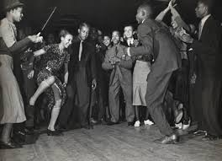
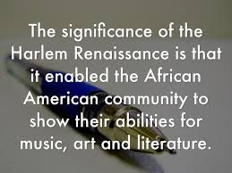
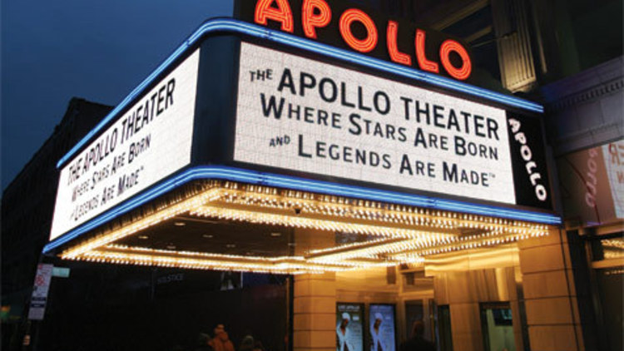
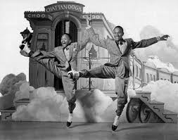
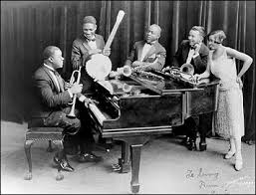

Slide 59
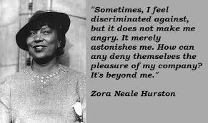
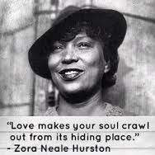

Slide 60
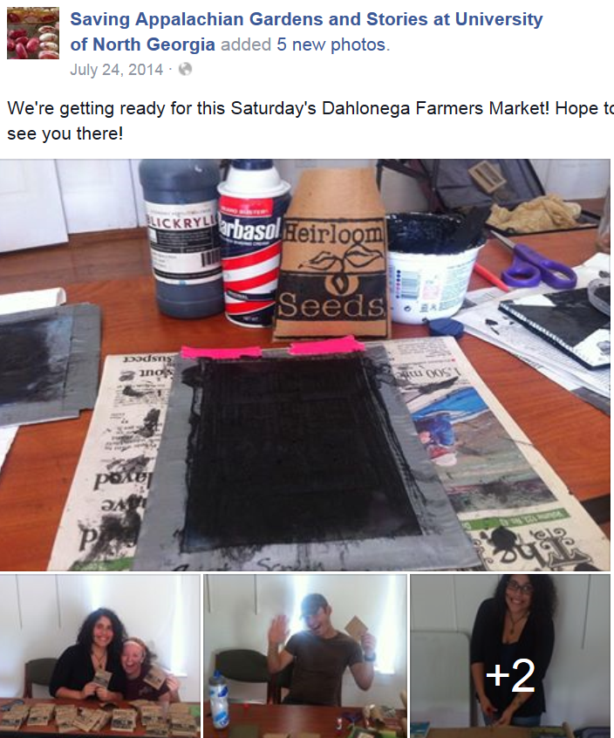
P
Participatory Action Research
Civic and Creative Arts Renewal

Slide 61
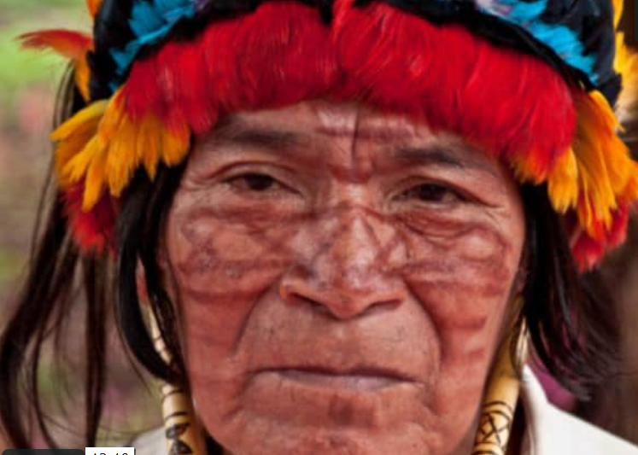
INDIGENOUS-MODERN TRANSFORMATIONS
“The Pachamama Alliance is an alliance between the Achuar – the Condor people of the Ecuadorian amazon – and the modern world – the Eagle people of the North. In the 1990s, the Achuar of the Ecuadorian Amazon began seeing the threat of oil development coming to their ancient pristine territory. “
http://www.pachamama.org/blog/the-eagle-and-the-condor-prophecy

Slide 62
from http://www.pachamama.org/
“The Achuar decided to reach out to the modern world to form an alliance that would equip them to protect their land and culture and at the same time change the dream of the modern world that drives the consumption threatening their land and culture.
Our alliance with the Achuar is a reciprocal partnership where the “mind” of the modern world helps the Achuar stand for their land and culture and the “heart” of the Achuar culture helps to educate and inspire people all over the world through our transformative workshops.”

Slide 63
What is the significance of this feminine principle in the practice of dialogue?
It relates us directly to the mystery that is at the heart of our being and at the ground of all life-- gives us an inner experience that cannot be taken away by an outside force.
It serves as a matrix energy from which a new shared commons can arise– links our inner body to outer place, allowing us to feel literally ‘at home’.
It creates a womb-like presence that supports, nurtures and nourishes all life-- restores justice by clearing the path to optimal human development.

Slide 64
How does Dialogue Contribute to Democracy, Humanization and Radical Social Transformation?
Practice of dialogue cultivates our humanity.
Releases us from myths of alienation and inadequacy.
Allows us to recognize what is universal about the process of humanization.

Slide 65
How does Dialogue Contribute to Democracy, Humanization and Radical Social Transformation
?
Gives us a bio-political respect for human needs for fulfillment. Encourages us to create and protect a culture of trust and critical thinking where optimal social creativity can flourish.
Allows us to participate in egalitarian relationships that question and transform the status quo authoritarianism. Opens the door to a vision and practice of democracy as radical inclusivity.

Slide 66
How does Dialogue Contribute to Democracy, Humanization and Radical Social Transformation?
  Allows us to recognize all people as part of a larger movement of humanization and to identify first as a World Citizen.
  Inspires us to understand ourselves as role models in the journey towards human maturation, social creativity, and cultural refinement and to accept new standards of responsibility that protect all life.

Slide 67
Vision of a New Democracy that Protects Humanization
Democracy as participation, inclusivity and reasoning in public sphere must be supplemented with practices of self-cultivation and cultivation of generosity of being that go beyond dualism of private and public.

Slide 68
Public discourse- Beauty, Dignity and Dialogue
Democracy is a mode of public reasoning and deliberate practical discourse where actors engage in moral argumentation– through a dialectical approach-- concerning the nature of self and society.
Transformation and insight that arises within the individual is the starting ground for deep structural social change that leads to and protects human liberation.

Slide 69
Community Making ppt

Slide 70
5. Analysis
Michael Jackson, ‘Earth Song’ Themes: Environmental Destruction, Call for Unity, World Citizen as Transformer, Deep Feeler, Ecological Citizen, Indigenous Reclaiming of Earth, Regeneration, Resurrection, Solidarity
https://www.youtube.com/watch?v=XAi3VTSdTxU
Abhay K., song “Earth Anthem”. Themes: Diversity, Unity, Perspective, Self-Awareness
https://www.youtube.com/watch?v=kQz8jxJLNOA
The Turtles, song “Earth Anthem”. Themes: Cognitive accommodations to grandeur, proportional, relational emotions, cosmology, earth-cosmos attunement
https://www.youtube.com/watch?v=wwAJdZ6x8I4
Baha’i Youth Conference Frankfurt 2013, song “World Citizen”. Themes: opening cultural boundaries in creative expression, youth movement, citizen participation, dynamic role relationships, liberation theology
https://www.youtube.com/watch?v=Pc6-ftmgqeY
Andrew Huang, song “Earth Hour Anthem”. Themes: intimacy, trust, the Faithful Lover archetype, Shakti, the ideal of romantic love and working idealism of world citizenship—love beyond boundaries- Romeo and Juliet
https://www.youtube.com/watch?v=MmwqfAFscaQ
David Sylvian and Ryuichi Sakamoto, song “World Citizen”. Themes: vulnerability, global crisis, apathy, the conscience, awakening, responsivity, depression and global caring, artistic temperament and universal message https://www.youtube.com/watch?v=G8yEe55gq2c

Slide 71
6. Group Discussion
What are themes emerging from concept of World Citizenship?
What are implications and deeper insights, related to World Citizenship, that emerge through an appreciation of body~place~commons?
How does our understanding of diversity, individuality, culture and human development transform when we consider the World Citizen concept?

